Slide 1
MAE 494/598
Application Development Project
Topic : Hot Water-Waste Harvest Device
Team 3 – Tabsheer A. Askari, Kenneth Dmello, Desirae Perales, Antonio Caputo

Slide 2
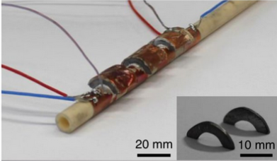
Introduction
A hot water waste harvest device is a type of energy recovery system that captures and recycle waste heat from hot water and uses it to generate electricity through thermoelectric generation (TEG).
This type of device can be used in a variety of applications such as industrial processes, power plants, and commercial buildings
It offers a sustainable and efficient way to recover heat and reduce energy consumption as well as reducing gas emissions

Slide 3
Project Objectives
To design and manufacture a Thermoelectric Material part which can be attached to hot water pipes and convert thermal energy to electrical energy.
To study how different parameters in the manufacturing process affect the performance of the thermoelectric setup.
To use this setup to harvest energy from hot water and use this energy to run a small electrical appliance (such as an LED light).

Slide 4
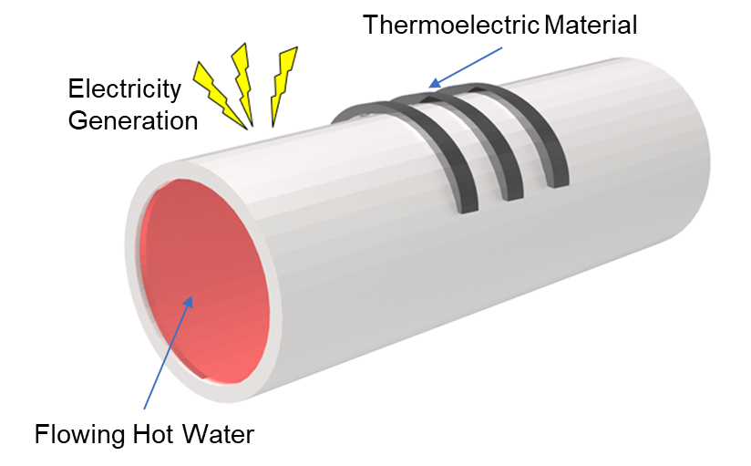
Features - Working Principles
1. Heat Exchange Mechanism:
The mechanism involves transfer of thermal energy from hot water waste source to the N-type and P-type materials, which are thermoelectric materials. When heat from the hot water waste source is transferred to an n-p-n-p junction of the materials, electrons in the N-type material move towards the P-type material, creating an electrical potential (voltage). This phenomenon is known as the Seebeck effect.
2. Thermoelectric Effect:
The Sb2Te3 material acts as a thermoelectric converter, which efficiently converts the temperature difference between the hot water waste source and the cold environment into electricity. The N-type and P-type materials have different electron densities, and the temperature difference between the two materials creates a voltage difference. When the N-type and P-type materials are connected in a circuit, an electric current flows due to the voltage difference created by the temperature gradient. It is also a reversible process too, so when electricity is passed through it, the materials can act as a cooling element.

Slide 5
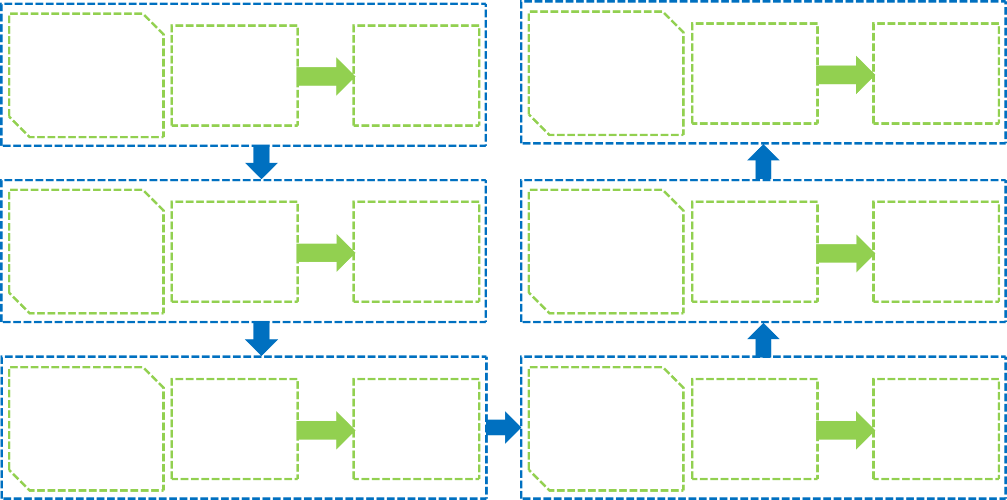
Manufacturing Process Flow

Slide 6
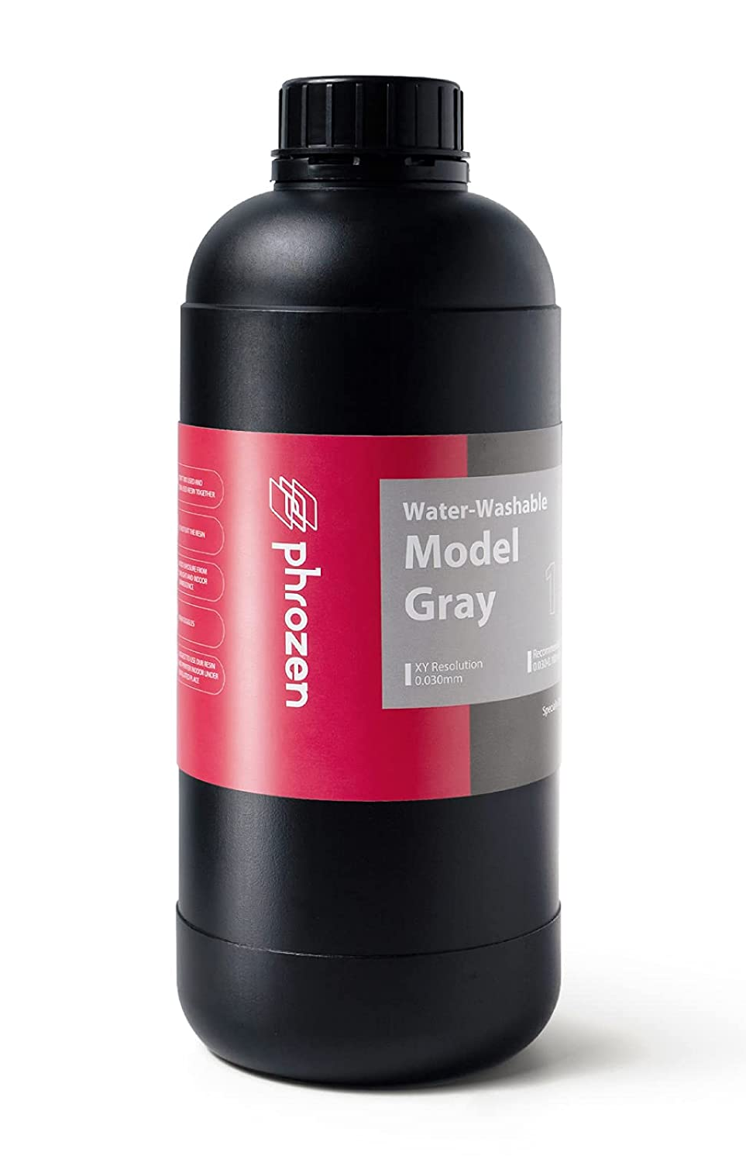
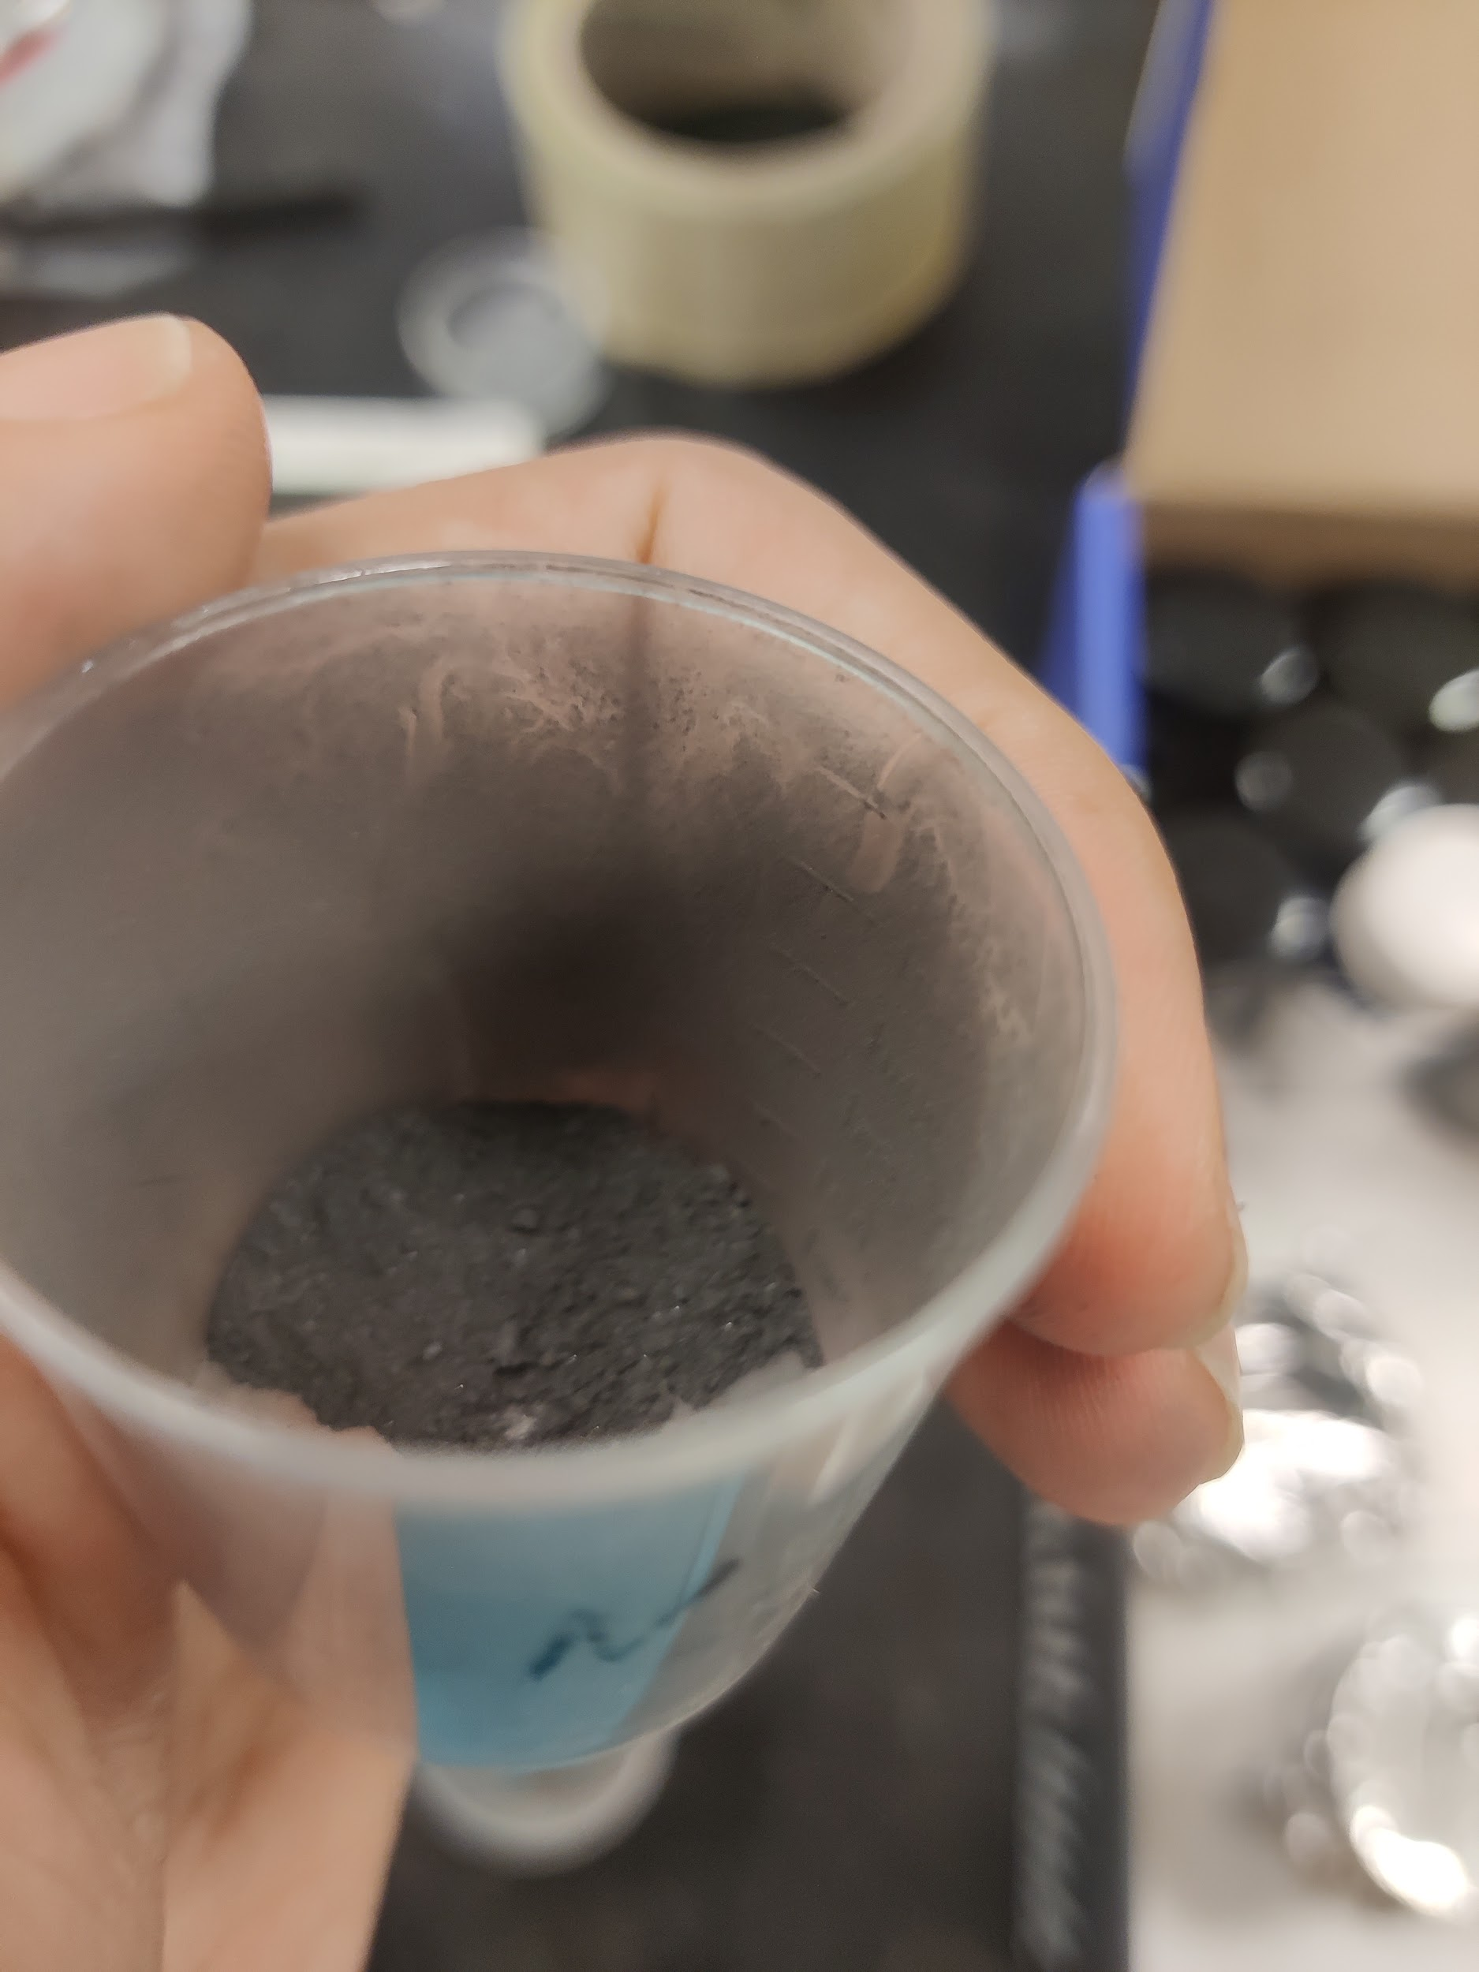
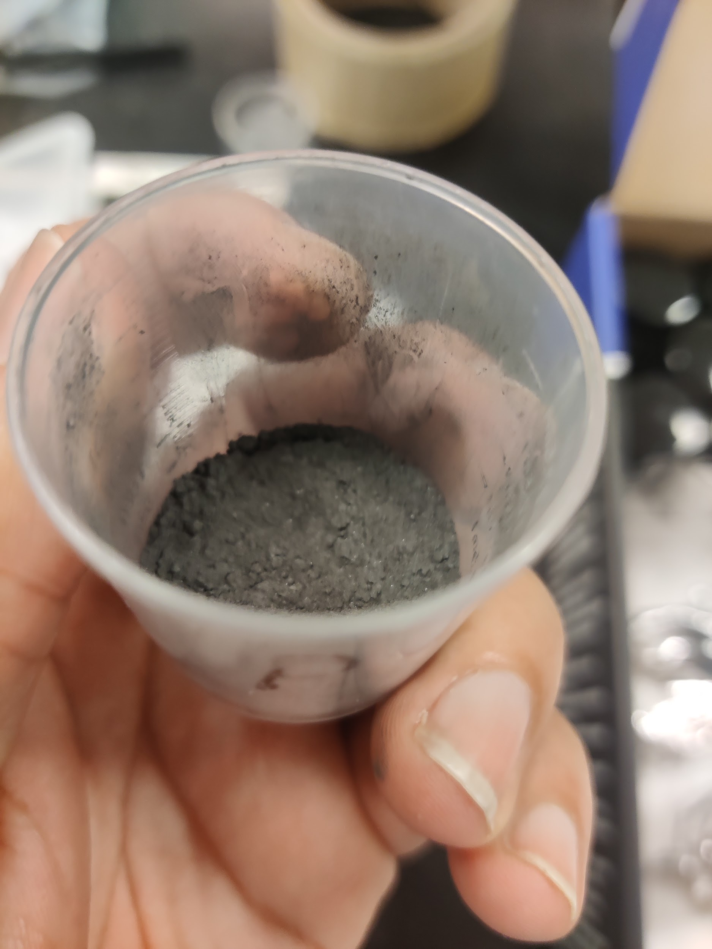
Basic Construction
Materials used for construction:
Thermoelectric (TE) Material, which consisted of p-type (Sb2Te3) and n-type (Bi2Te3) thermoelectric couple arrays.
Resin used to create Pipe and molds.
Conducting copper wires and LED light
N-type material
P-type material
Resin

Slide 7
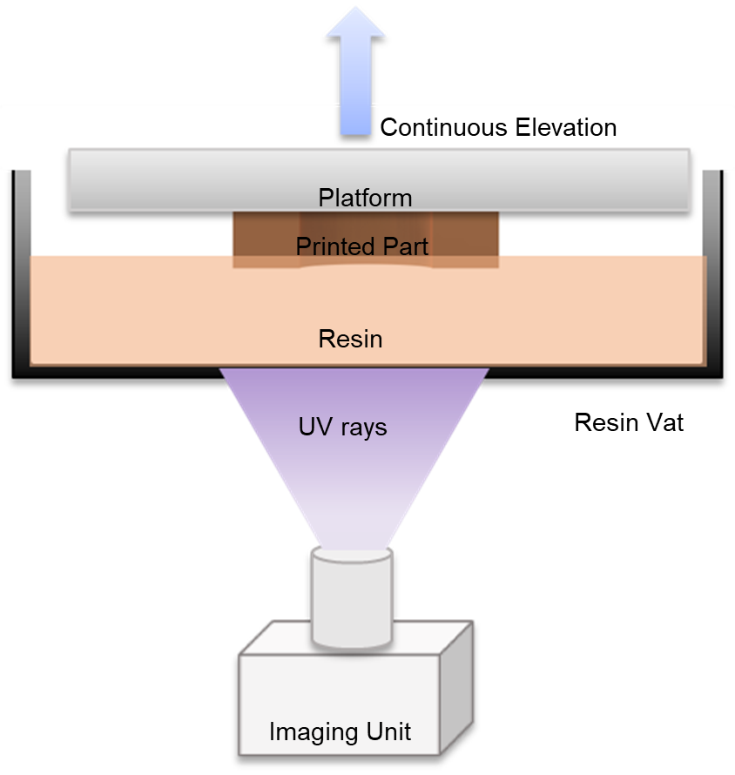
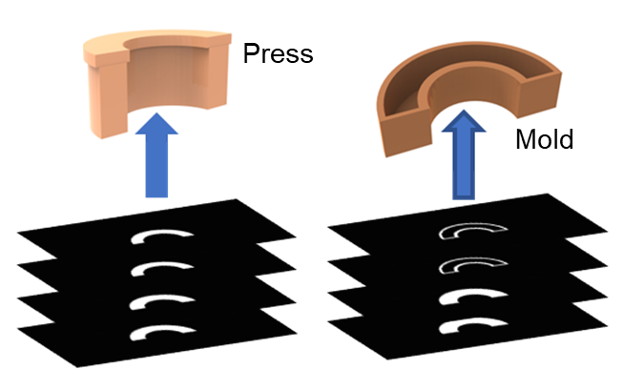
Basic Construction
Mold & Press Printing:
Design of molds & presses on SOLIDWORKS
Slicing of molds on Chitubox.
3D printing using the sonic mini 4k SLA printer.

Slide 8
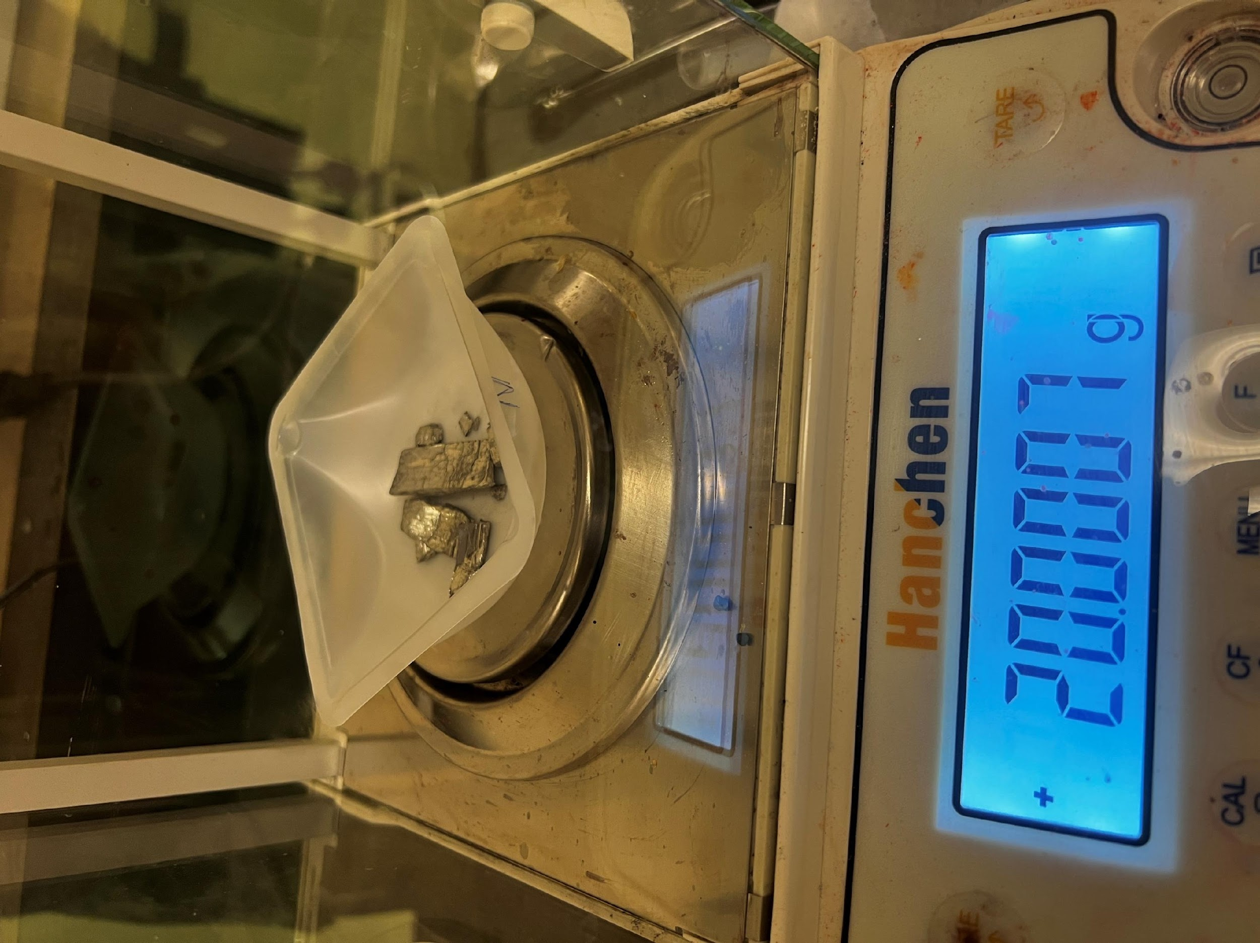
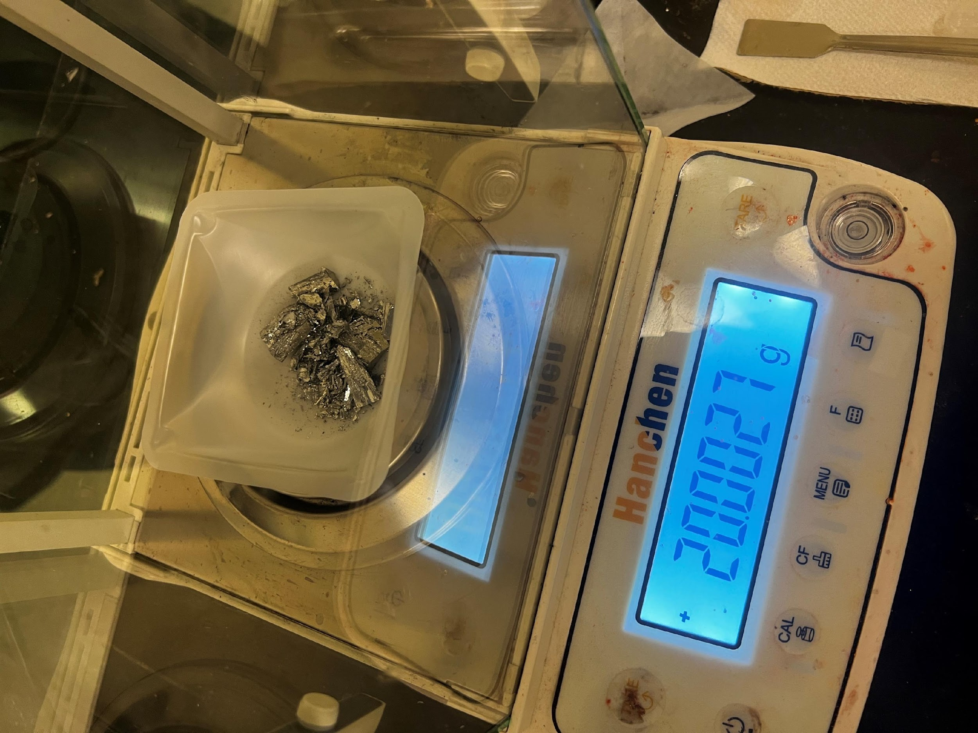
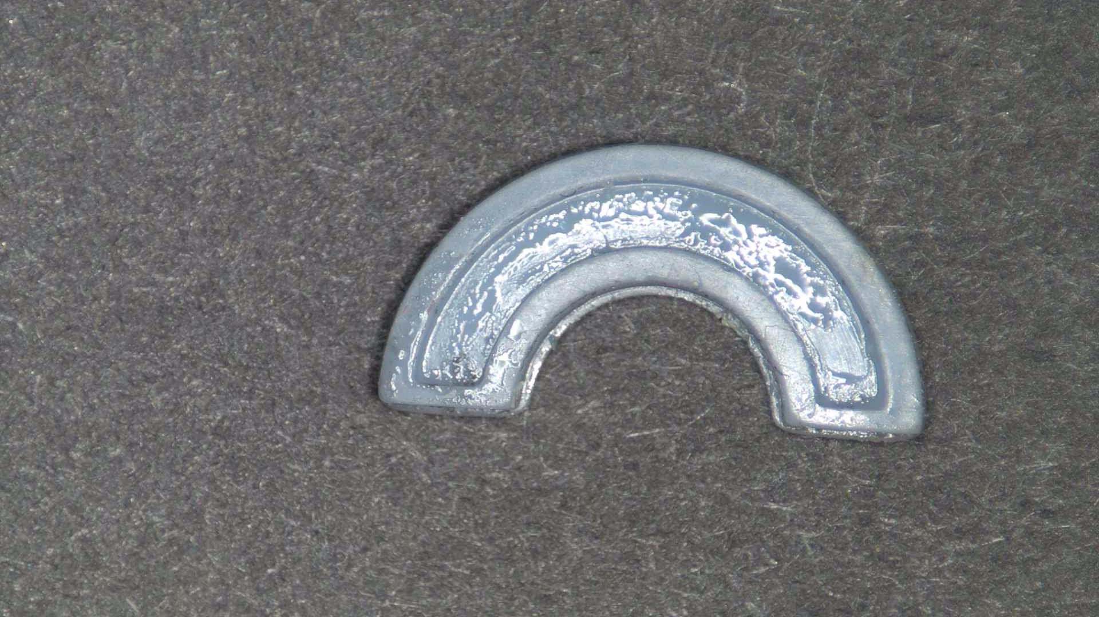
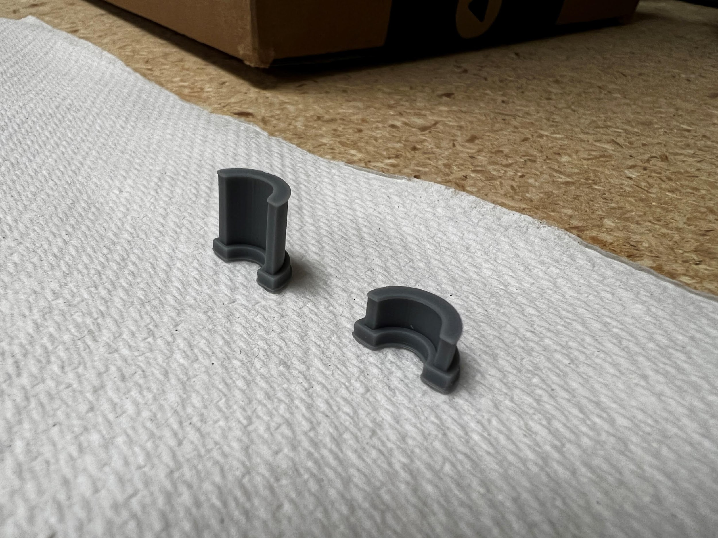
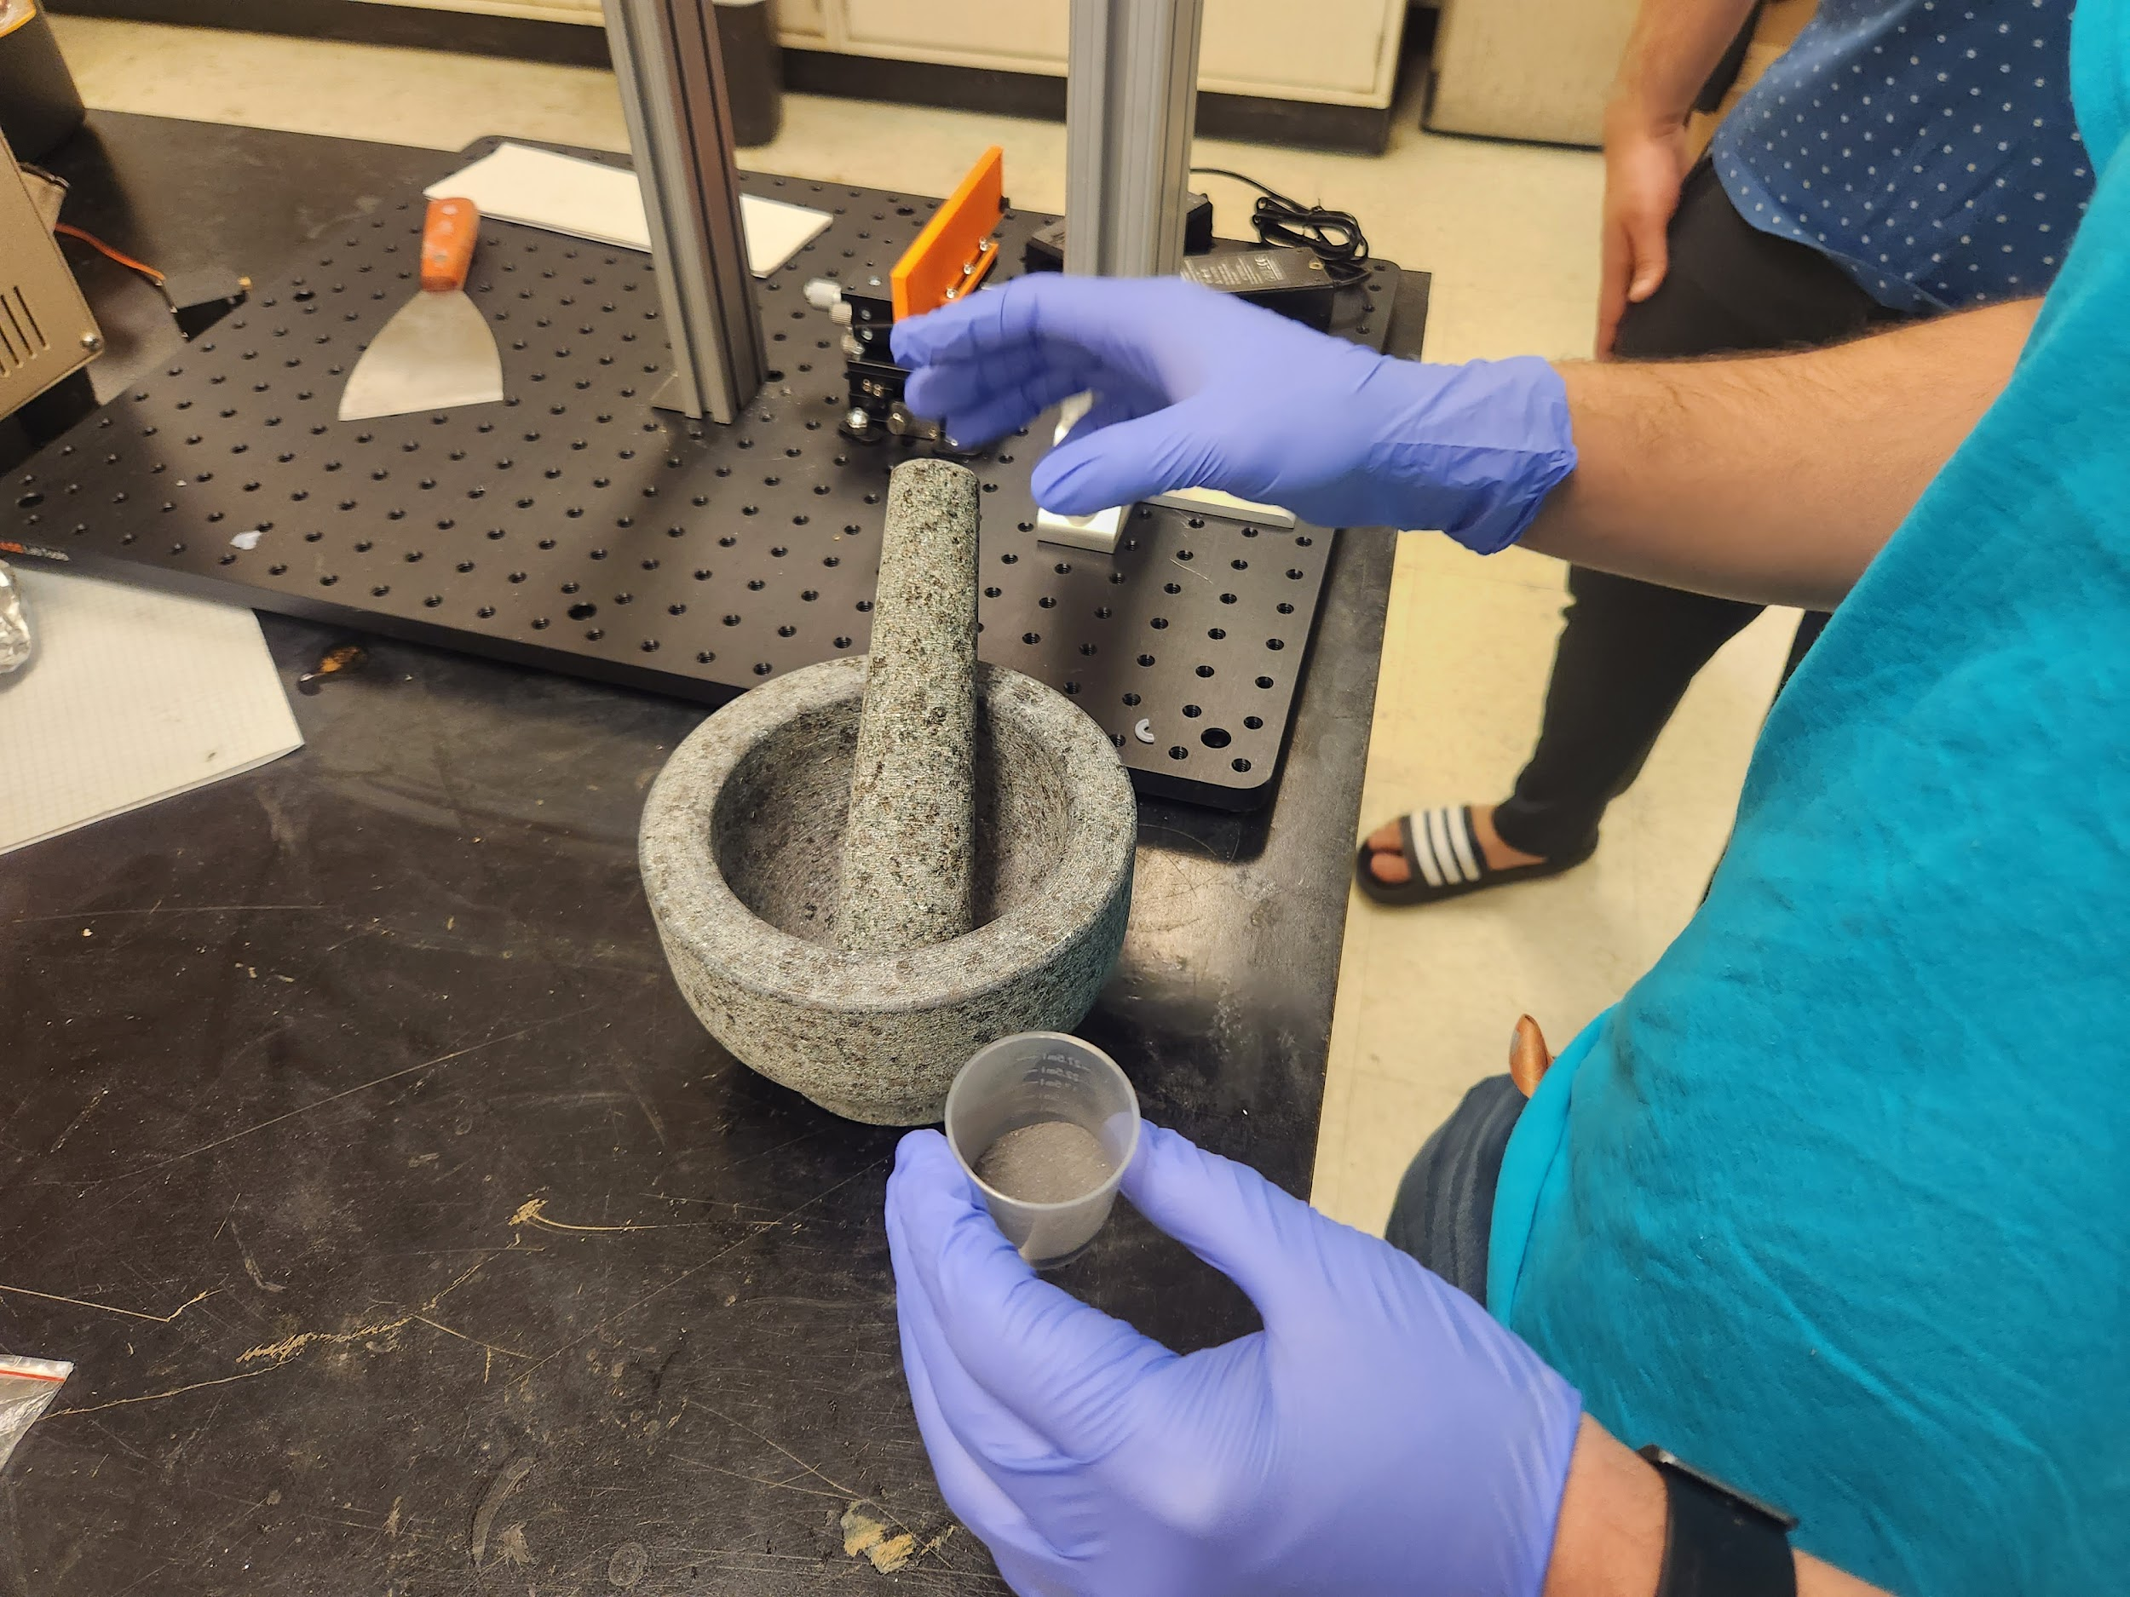
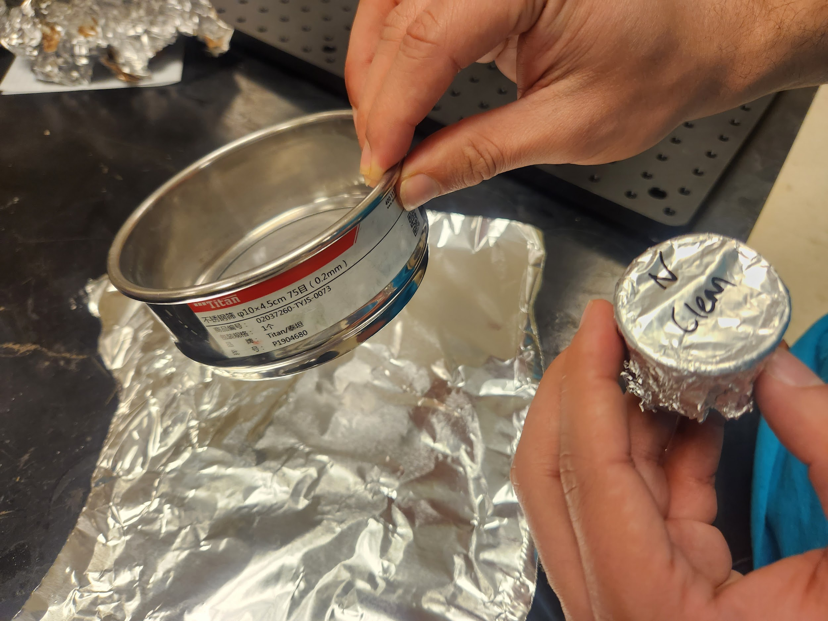
Basic Construction
Material Preparation & Mold Filling:
This process involved grinding both n- & p-types of materials and then passing them through a strainer with perforations of 100 and 200 micrometers.
The printed molds were filled with powdered material.
N-type (solid)
P-type (solid)

Slide 9
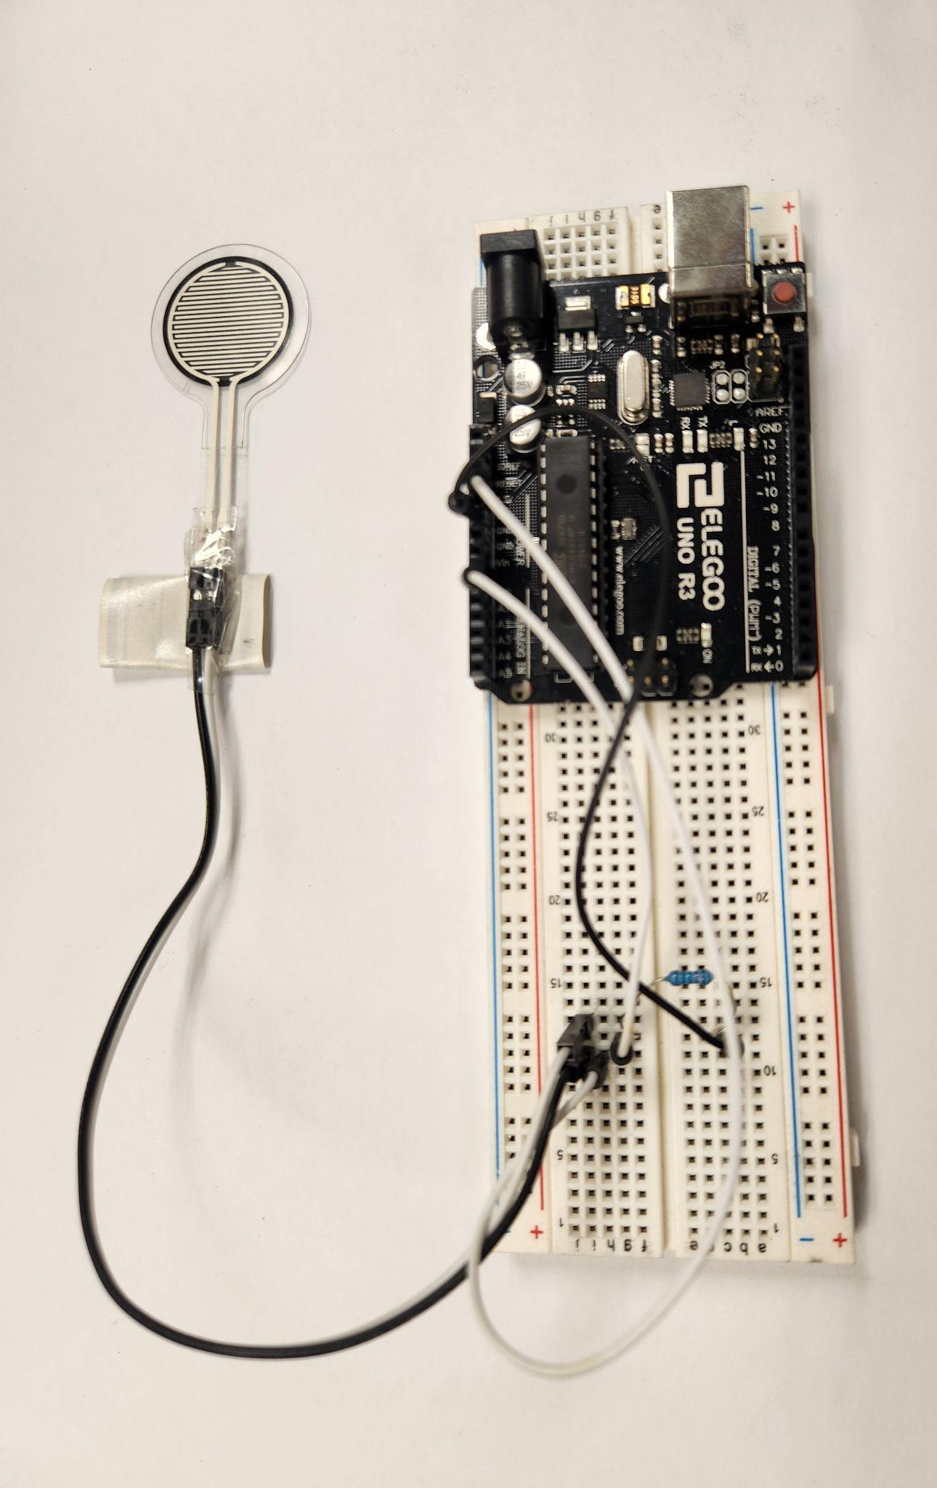
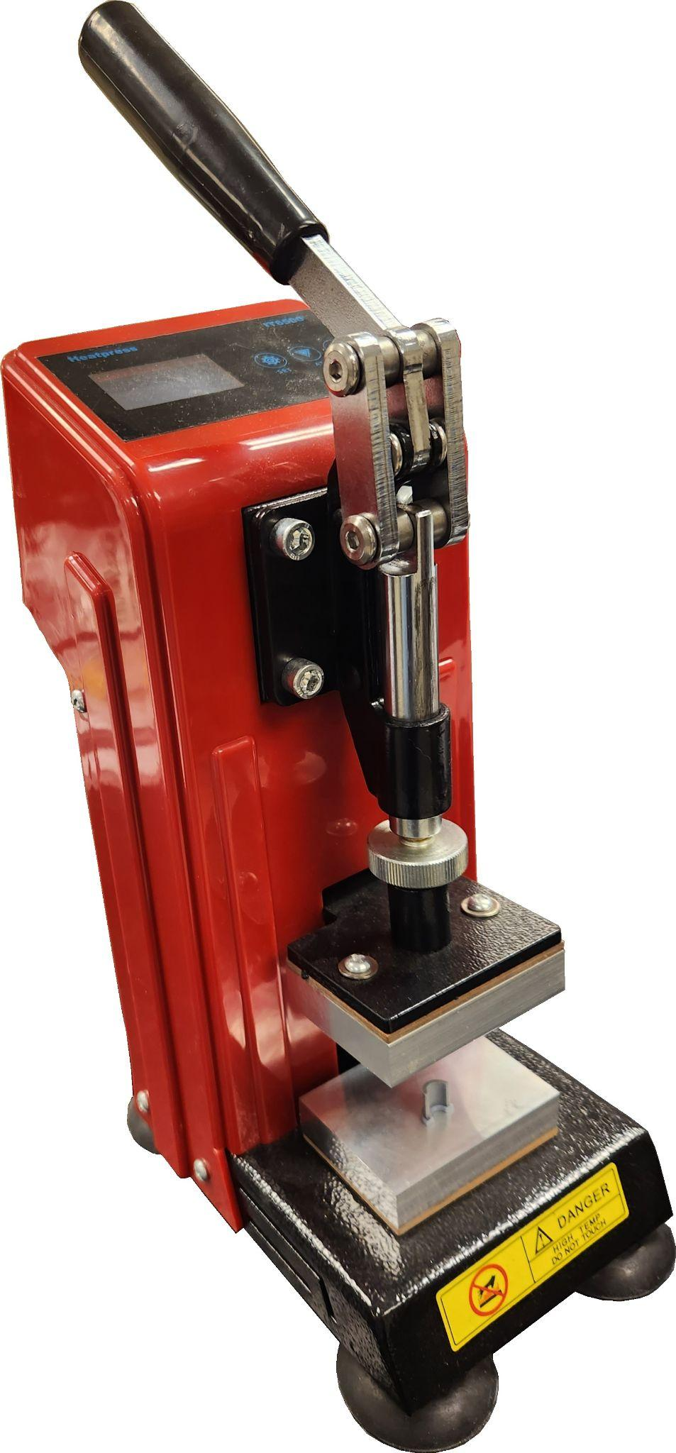
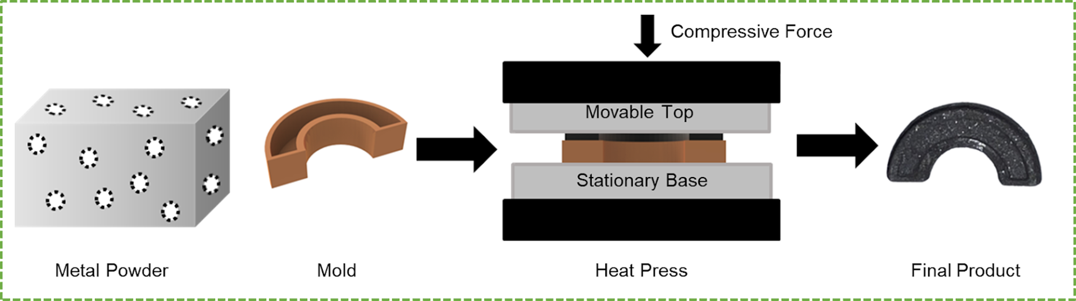
Basic Construction
Heat Pressing:
The material was pressed into the mold with the heat press.
The temperature and pressing force of the heat press were varied for different samples to investigate the effect on the resulting TE part.
Temperature (℃) | Force 1 | Force 2 | Force 3
Room Temp (~25) | Hand | 40% | 60%
75 | Hand | 40% | 60%
150 | Hand | 40% | 60%

Slide 10
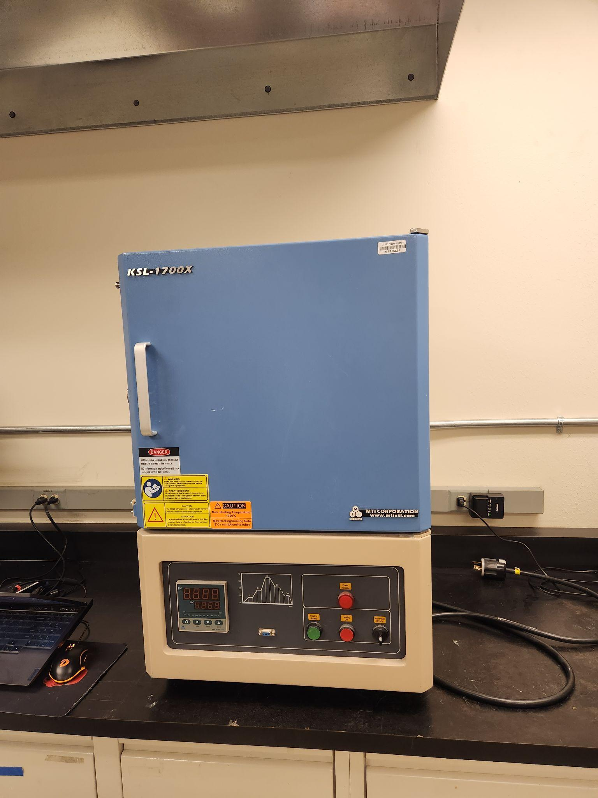
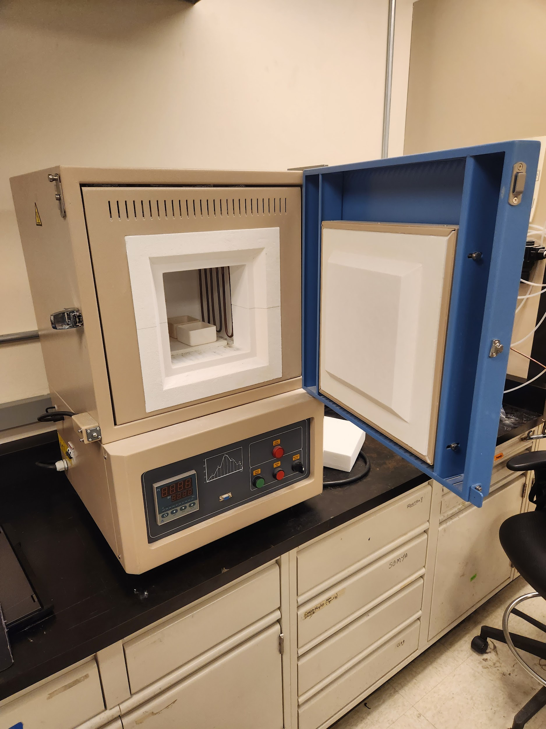
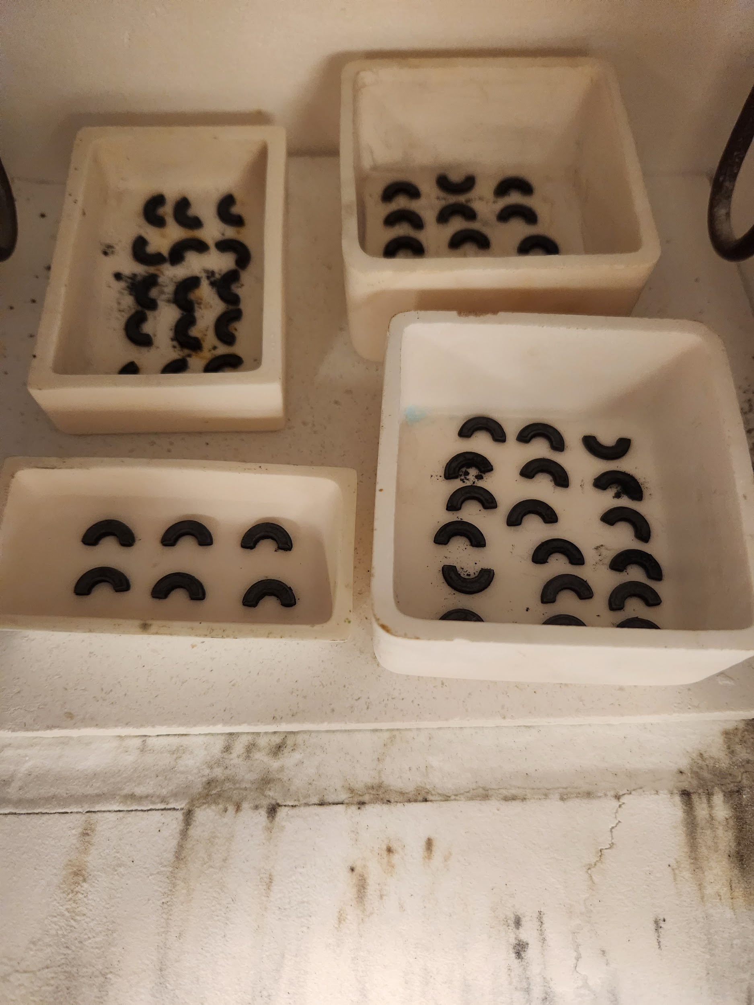
Basic Construction
Sintering the filled heat-pressed molds in the Furnace (KSL-1700X)

Slide 11
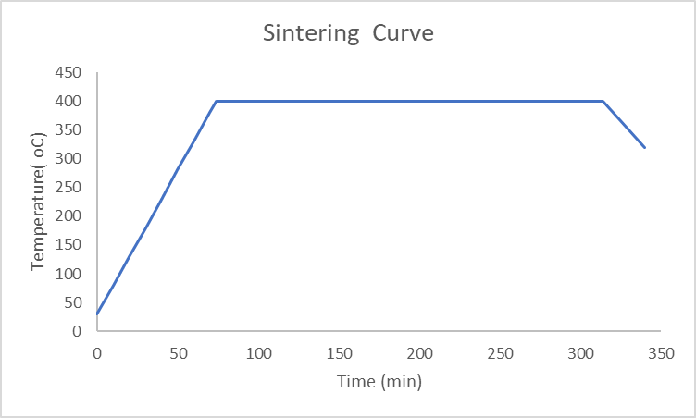
Sintering Curve
240 min
Furnace
cooling
Ramping rate 5℃/min

Slide 12
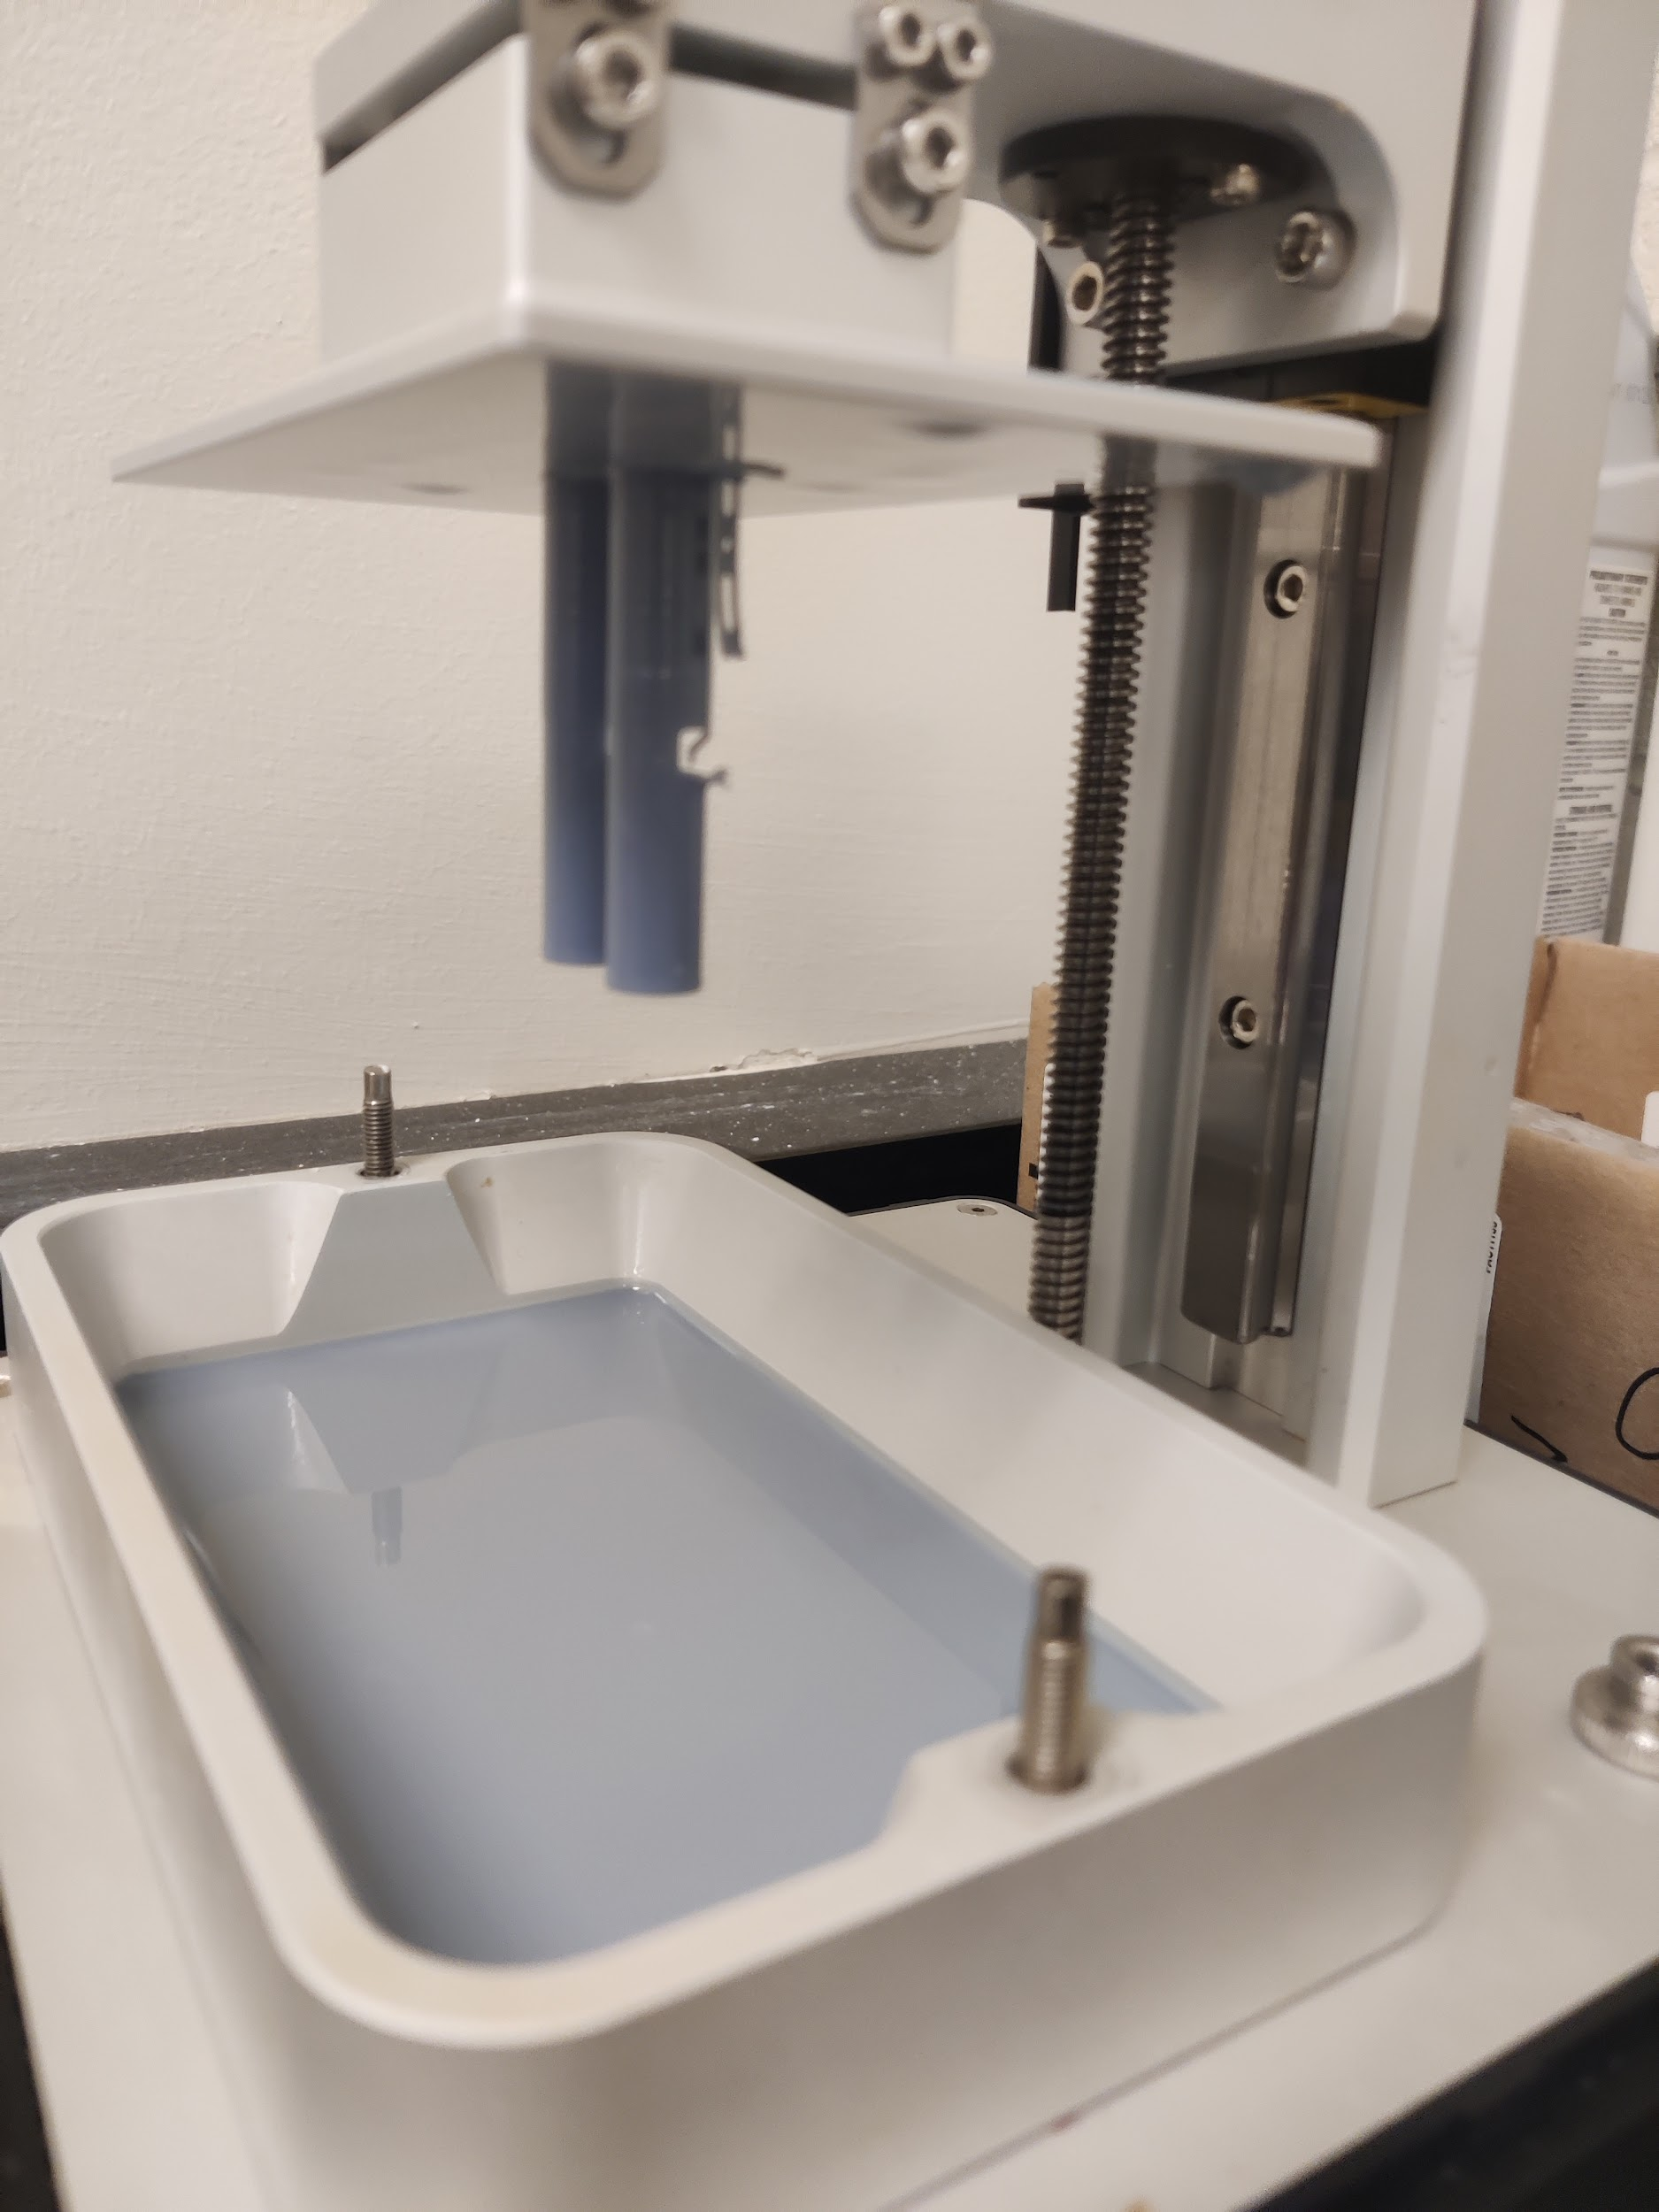
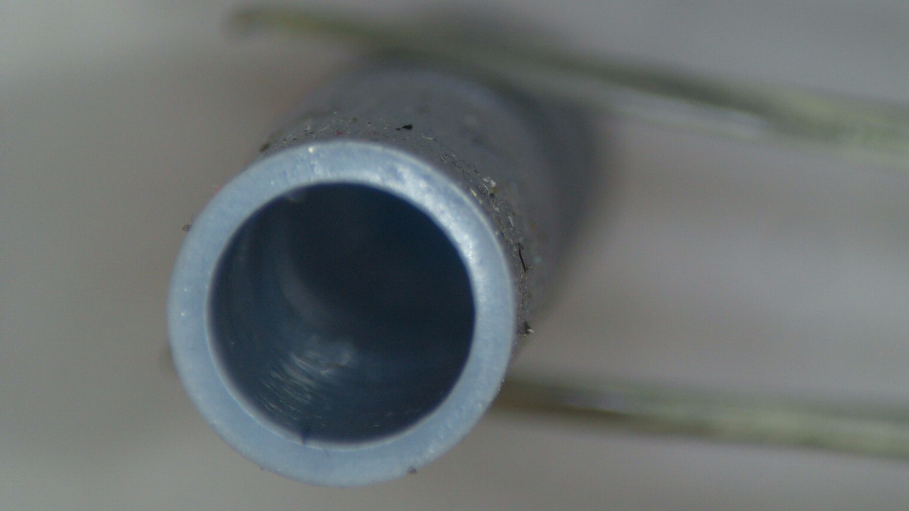
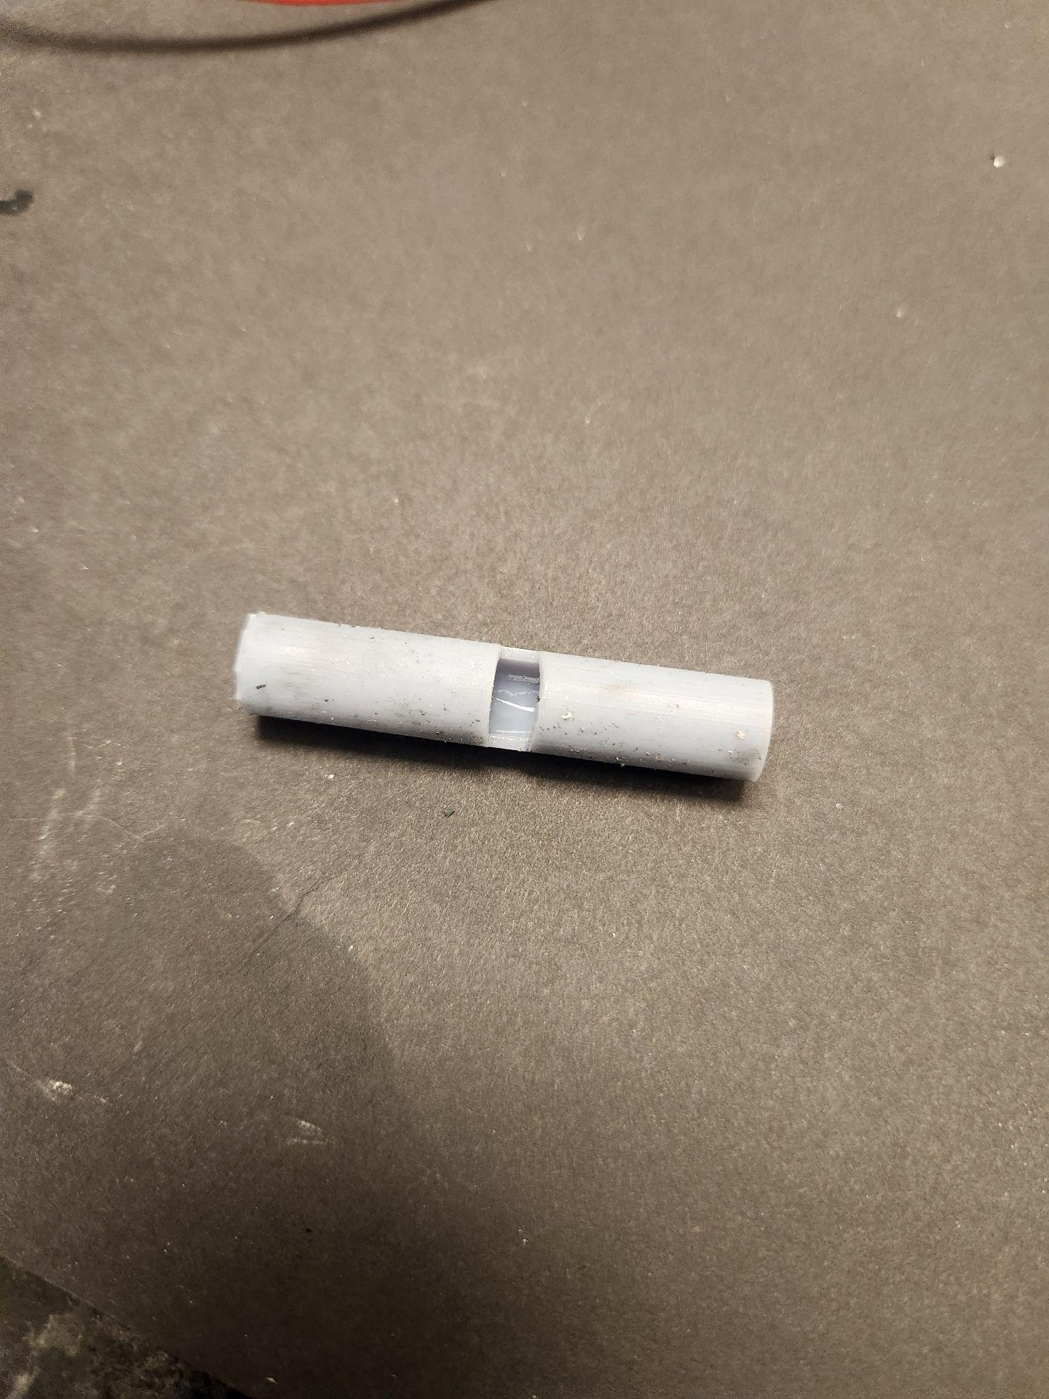
Basic Construction
Design of Test-Pipe:
Design of pipe on SOLIDWORKS
Slicing and adding supports for overhangs in Chitubox
3D printing using the Sonic Mini 4k SLA printer.

Slide 13
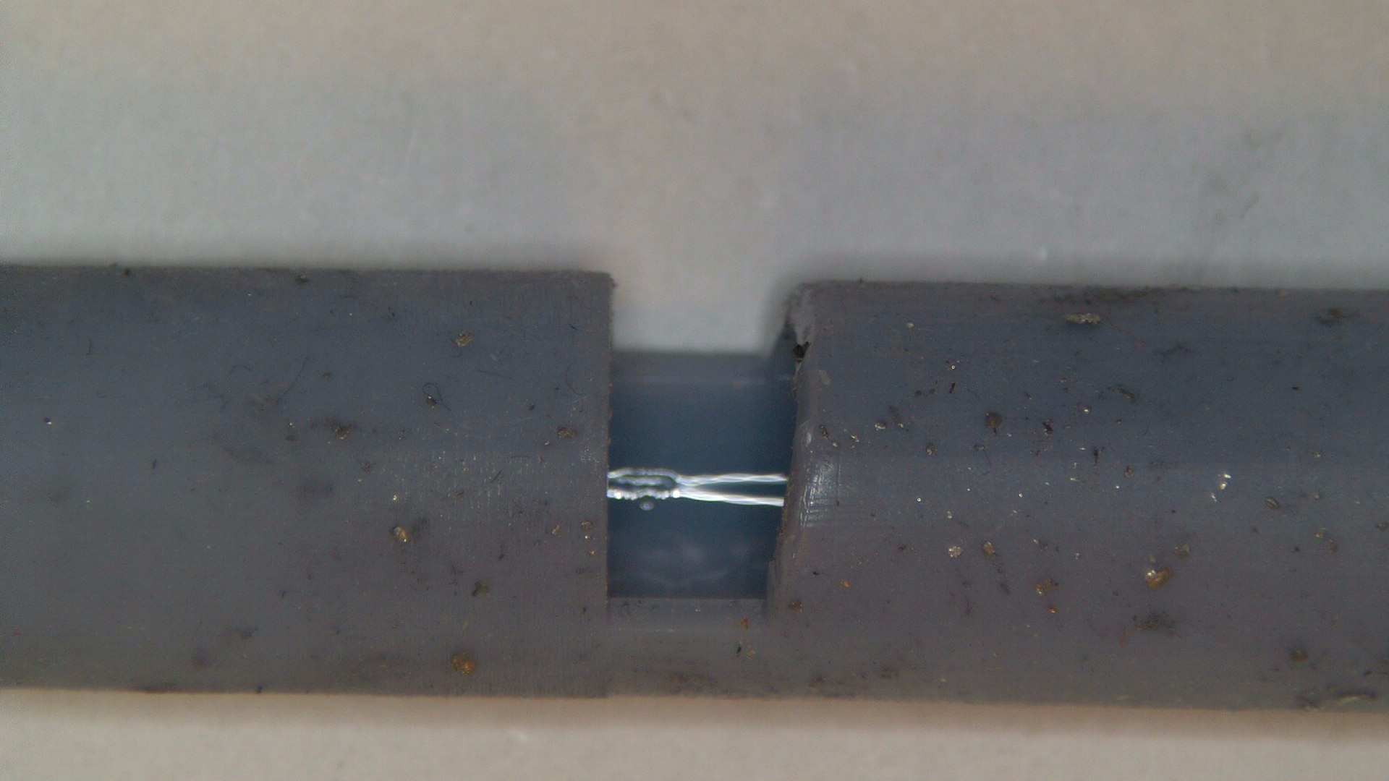
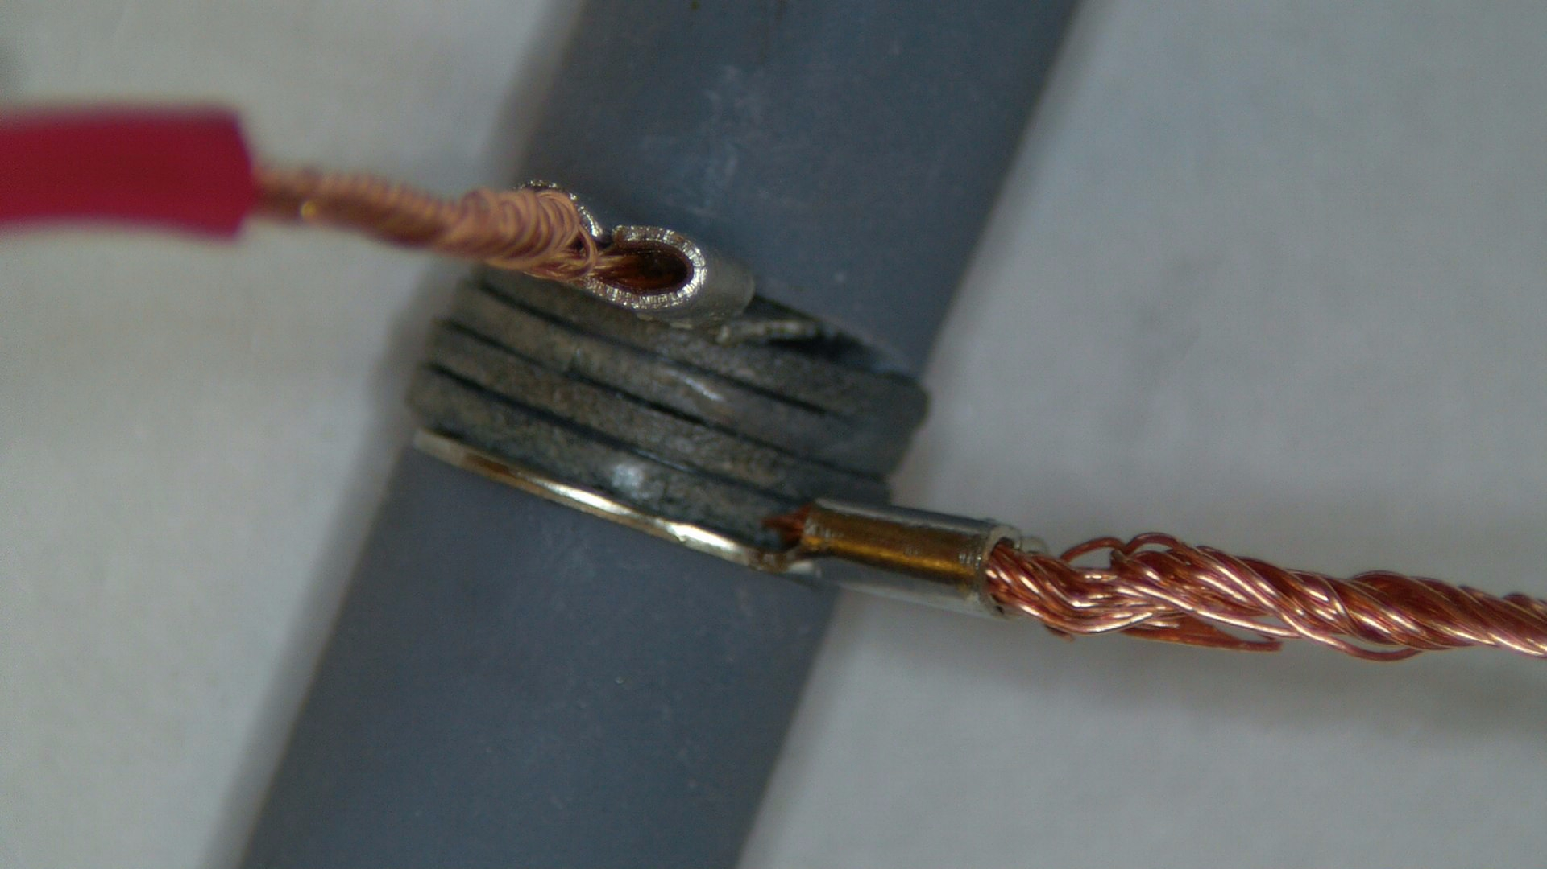
Basic Construction
Assembling the parts for experimentation
Placing N-type and P-type materials inside the groove of the test pipe.
A circuit for connecting electrical wires.
Placement of the device in the hot water-waste source.

Slide 14

Video

Slide 15
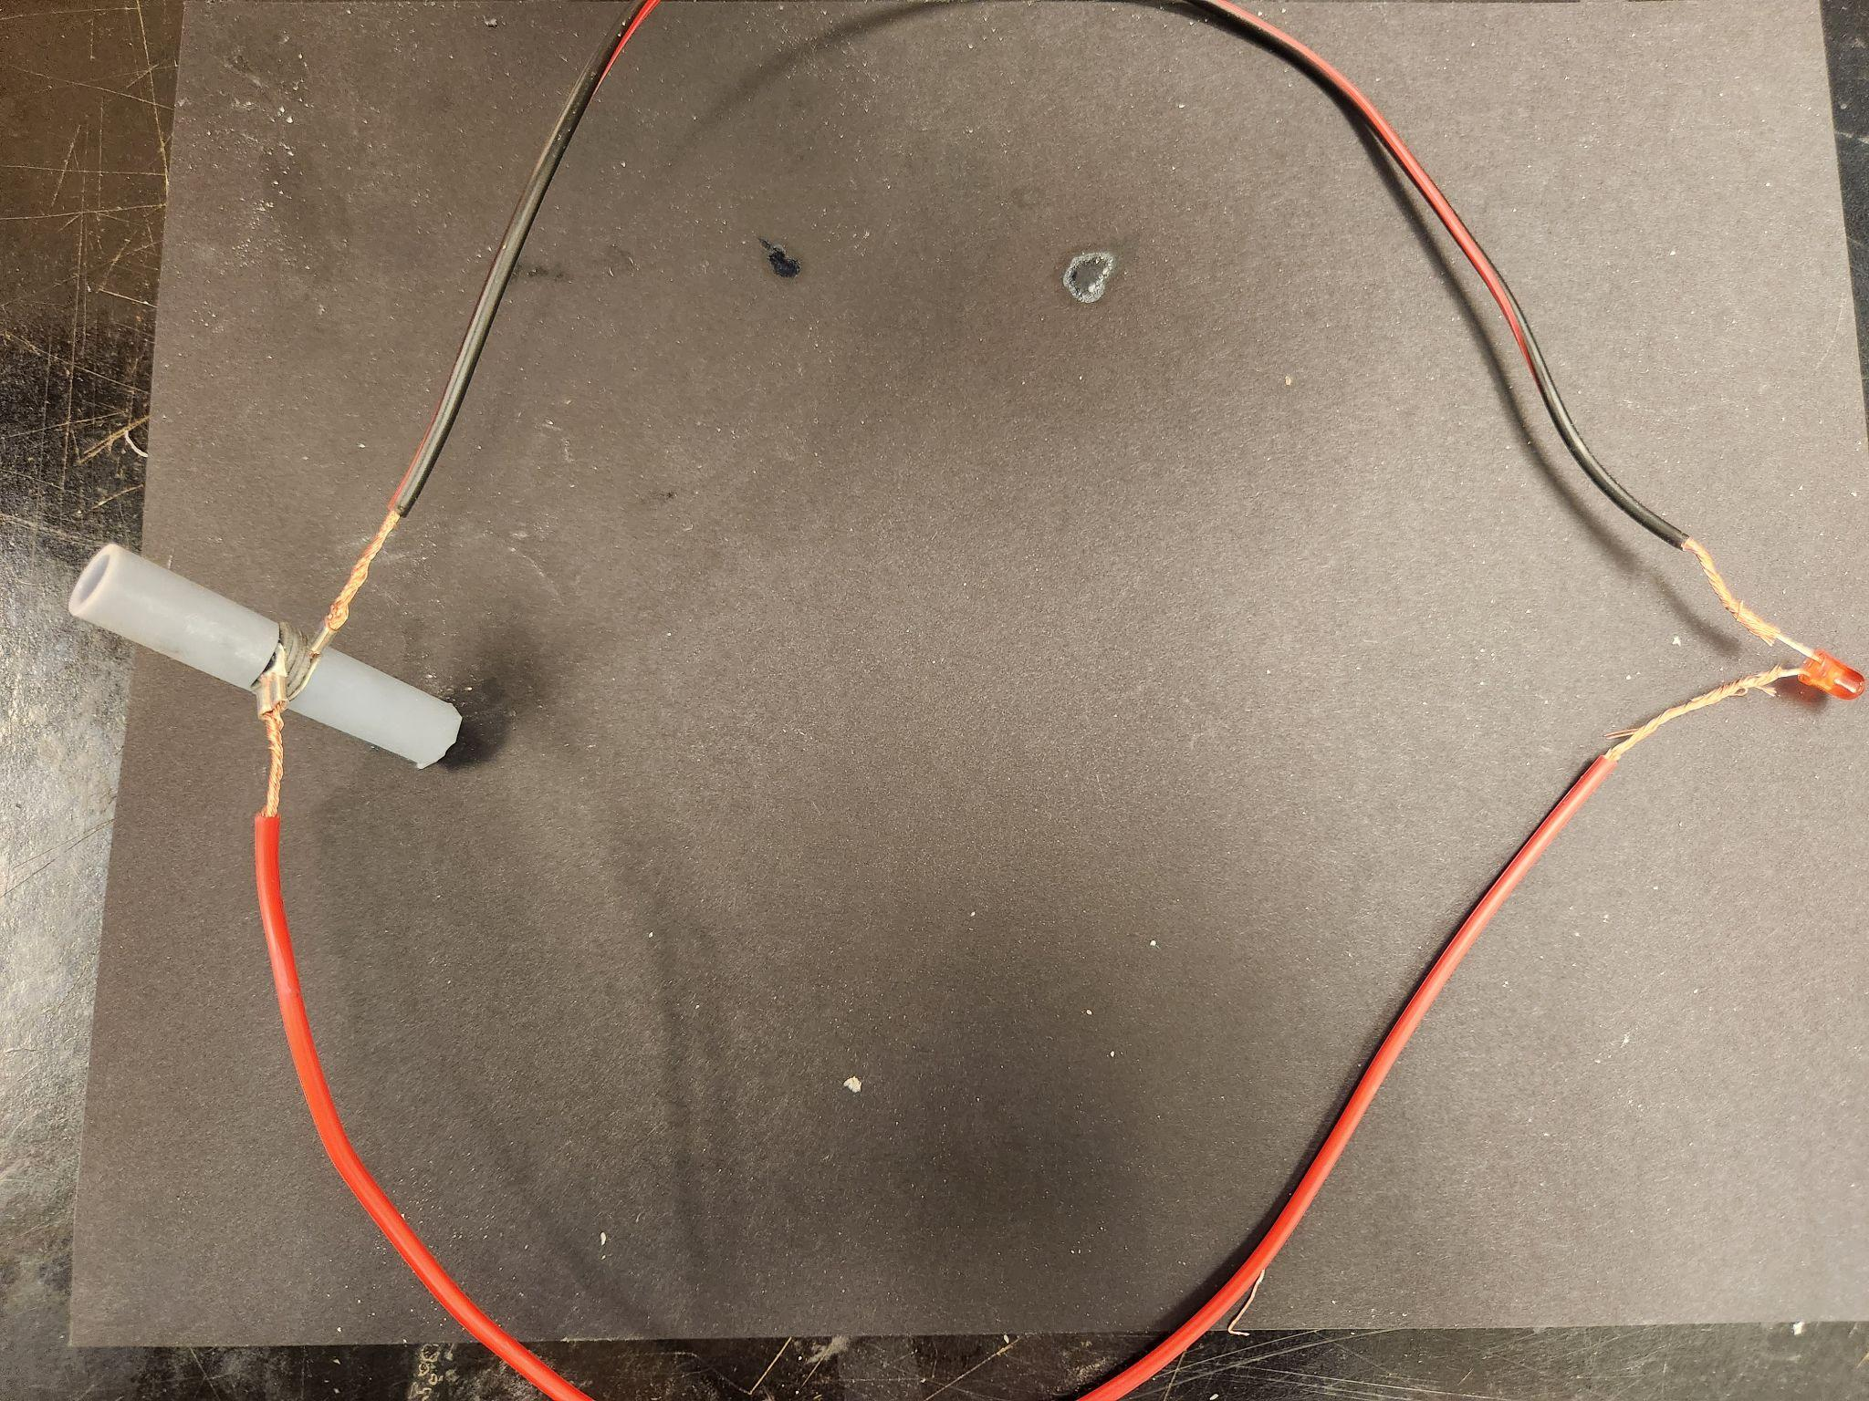
Mechatronics System/Components
The system consisted of 3 main components:
The TEG material,
The hot water tube,
The electrical components/circuitry to test whether the TEG material was producing any electricity.

Slide 16
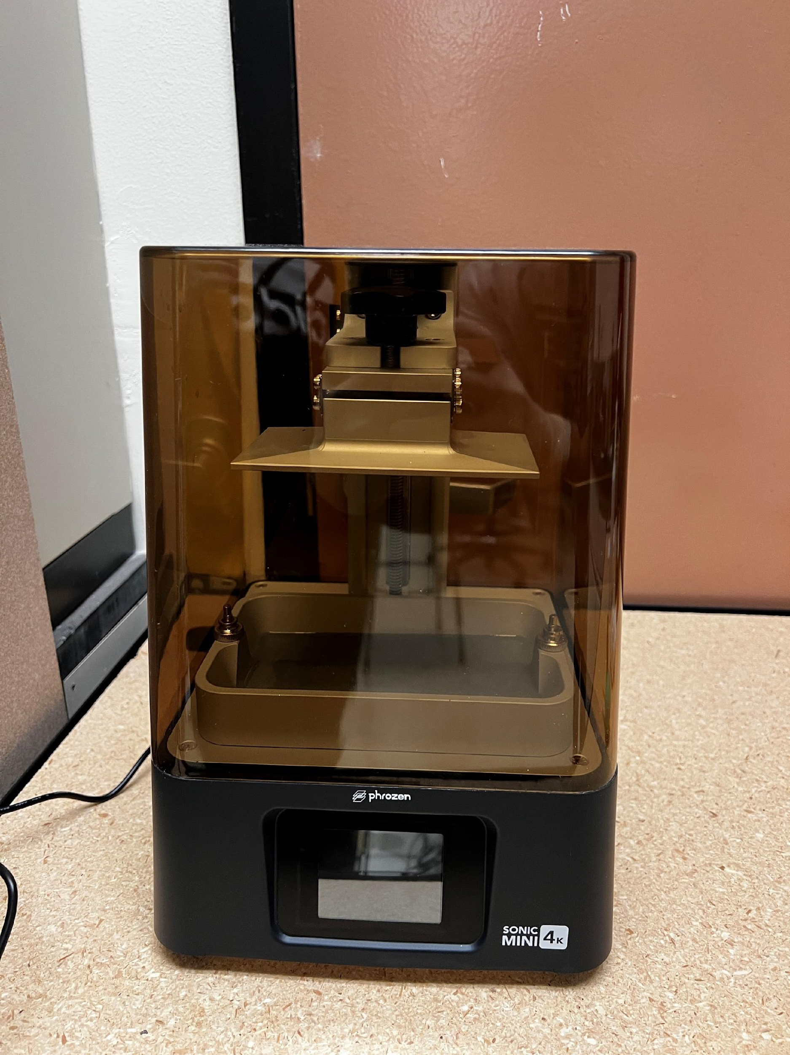
Mechatronics System/Components
There were several pieces of equipment we used during the manufacturing process for the TEG materials.
SLA 3D Printer - to print the molds and presses for the material, and to print the pipes for testing
Hot press - used to press and heat the powdered TEG material in the molds before sintering

Slide 17
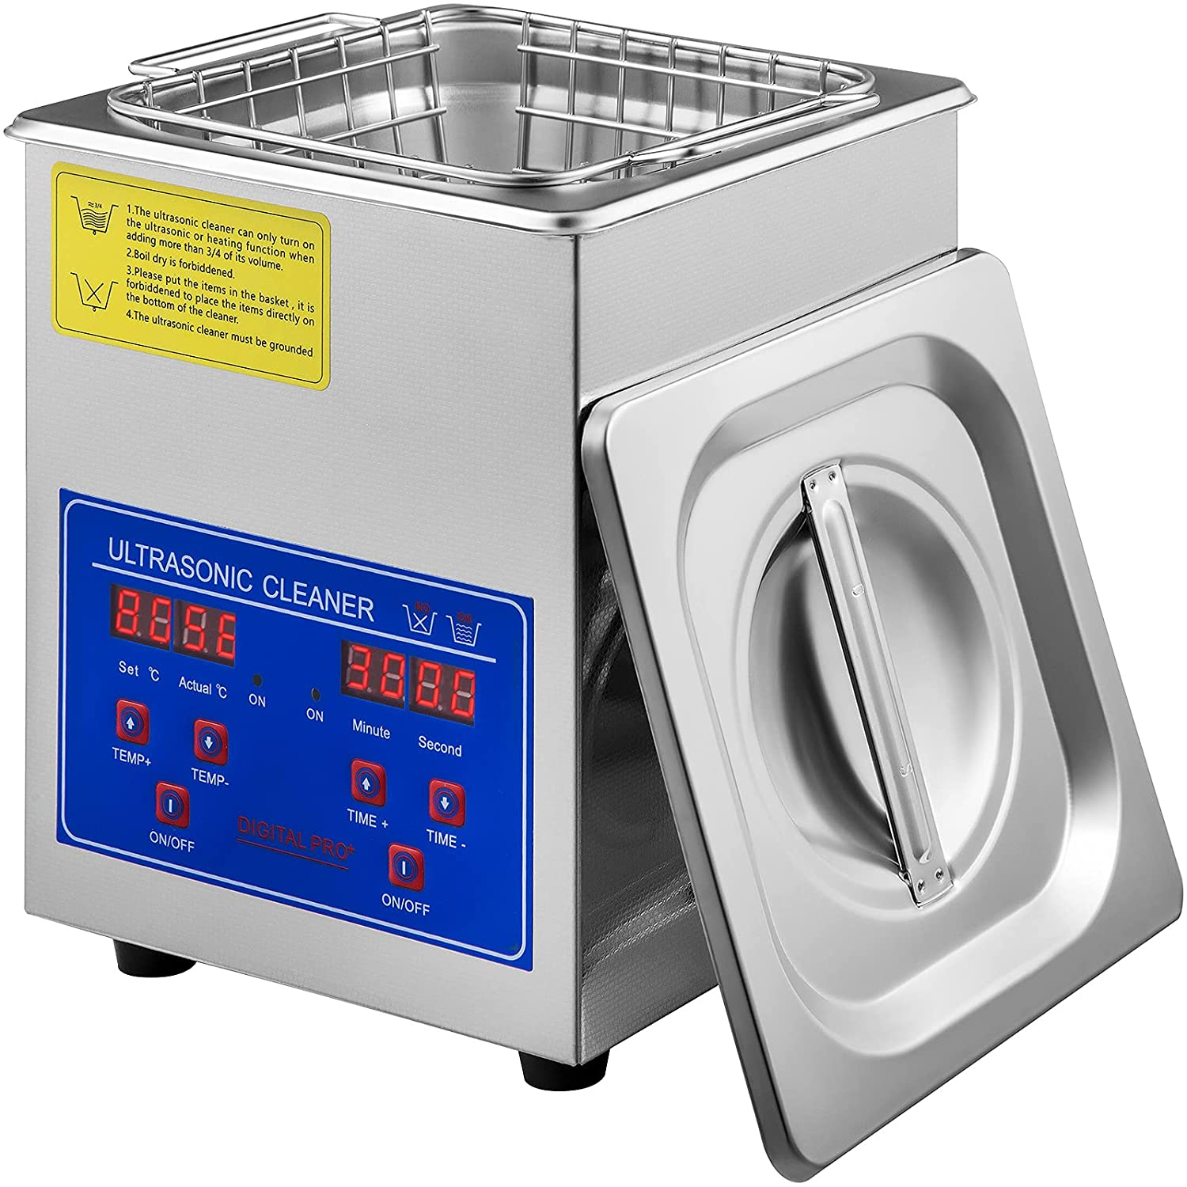
Mechatronics System/Components
Arduino Pressure sensor - used to measure how much pressure we were applying with the hot press on the molds while pressing
Furnace - used to sinter the material
Ultrasonic cleaner - we attempted to use this to clean the surface impurities off the material after sintering

Slide 18
Issues Faced & What We Learnt
There were several issues we faced in the progress of this project
Some molds did not cure well in the SLA printer
It was hard to handle the material and the molds due to the small size of the part
After the sintering process, the TE material part was brittle, as well as hard to handle (due to the small size).
After sintering, the parts were contaminated by a surface layer of polymer ash (from the molds).

Slide 19
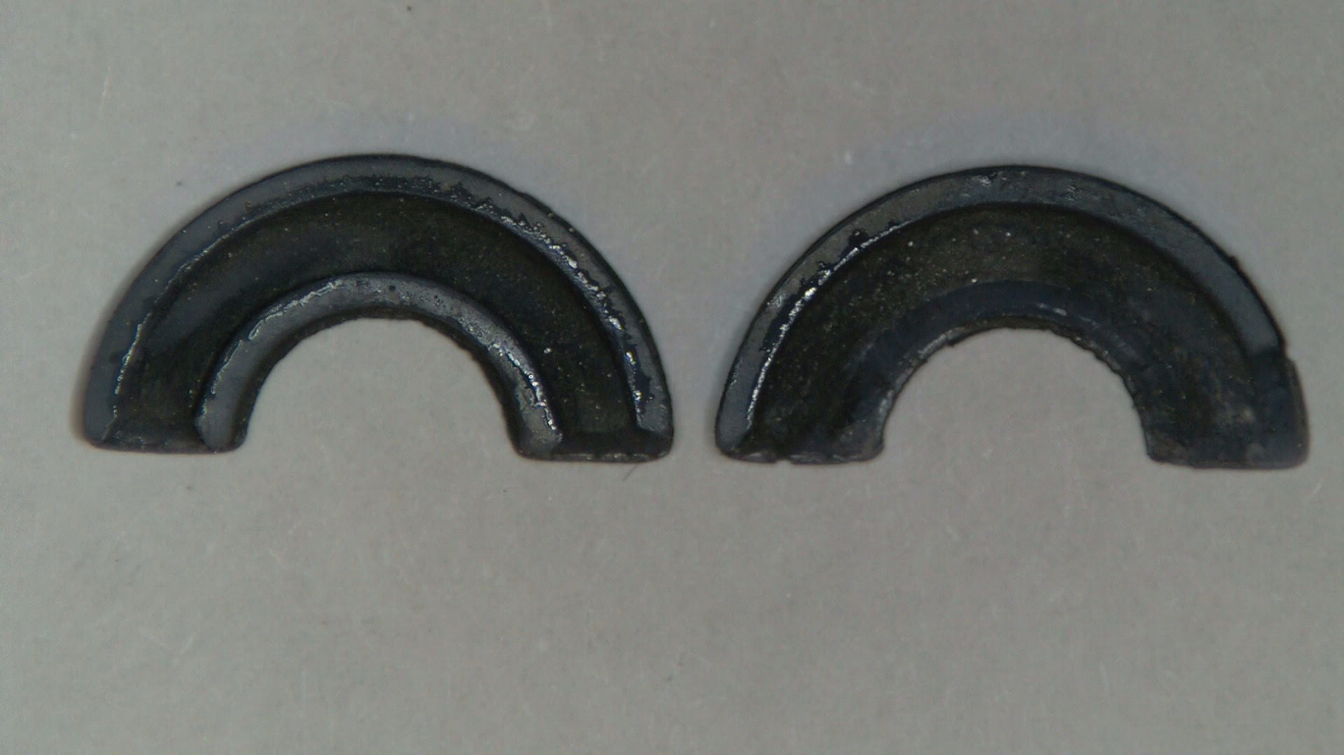
Issue 1: Some molds did not cure well in the SLA printer
Some of the 3D printed molds were unusable. Top layers of some of the molds did not adhere well and were dislodged/damaged when removed from the build plate.
Some of the molds were fragile and were damaged in the pressing process (see image below)

Slide 20
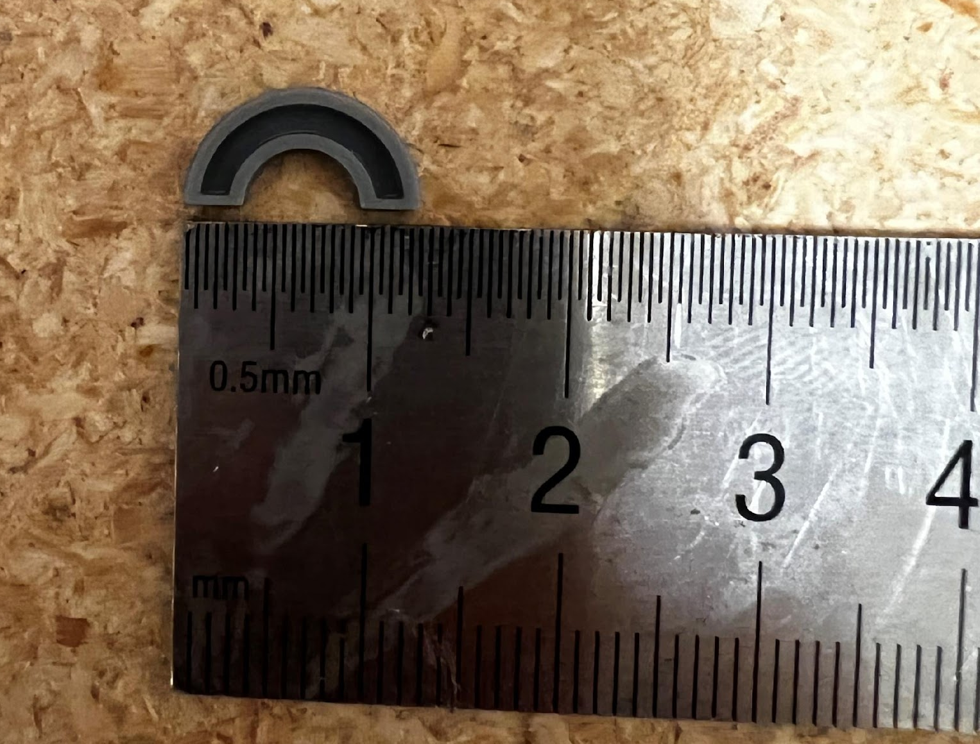
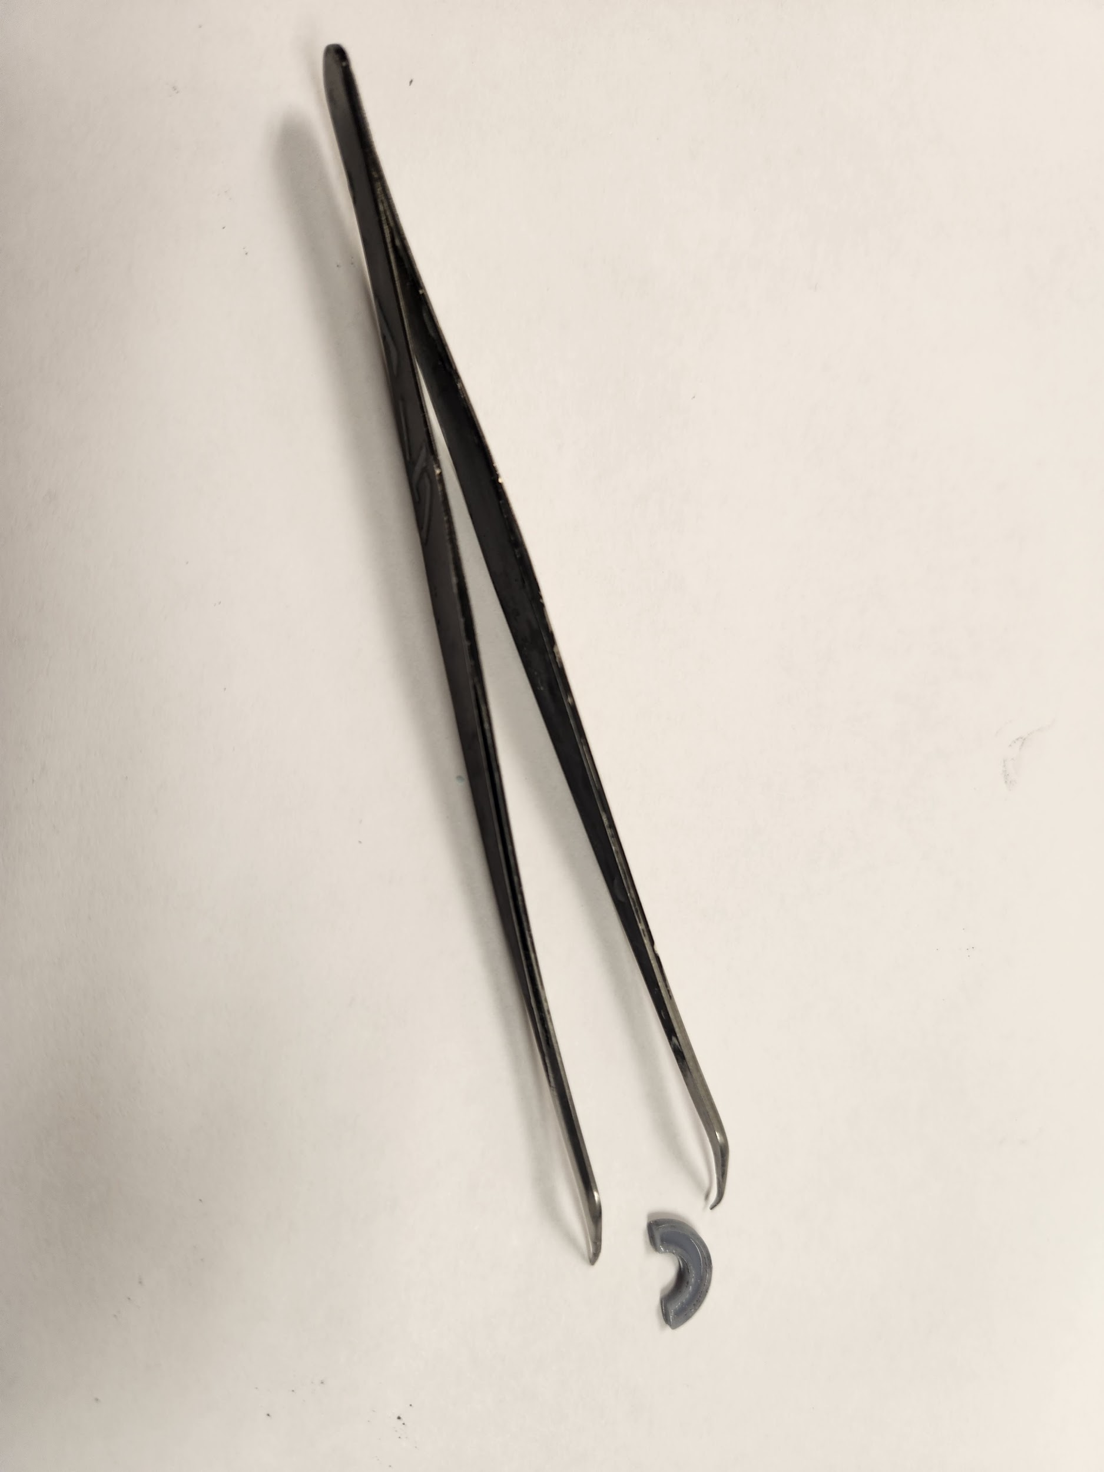
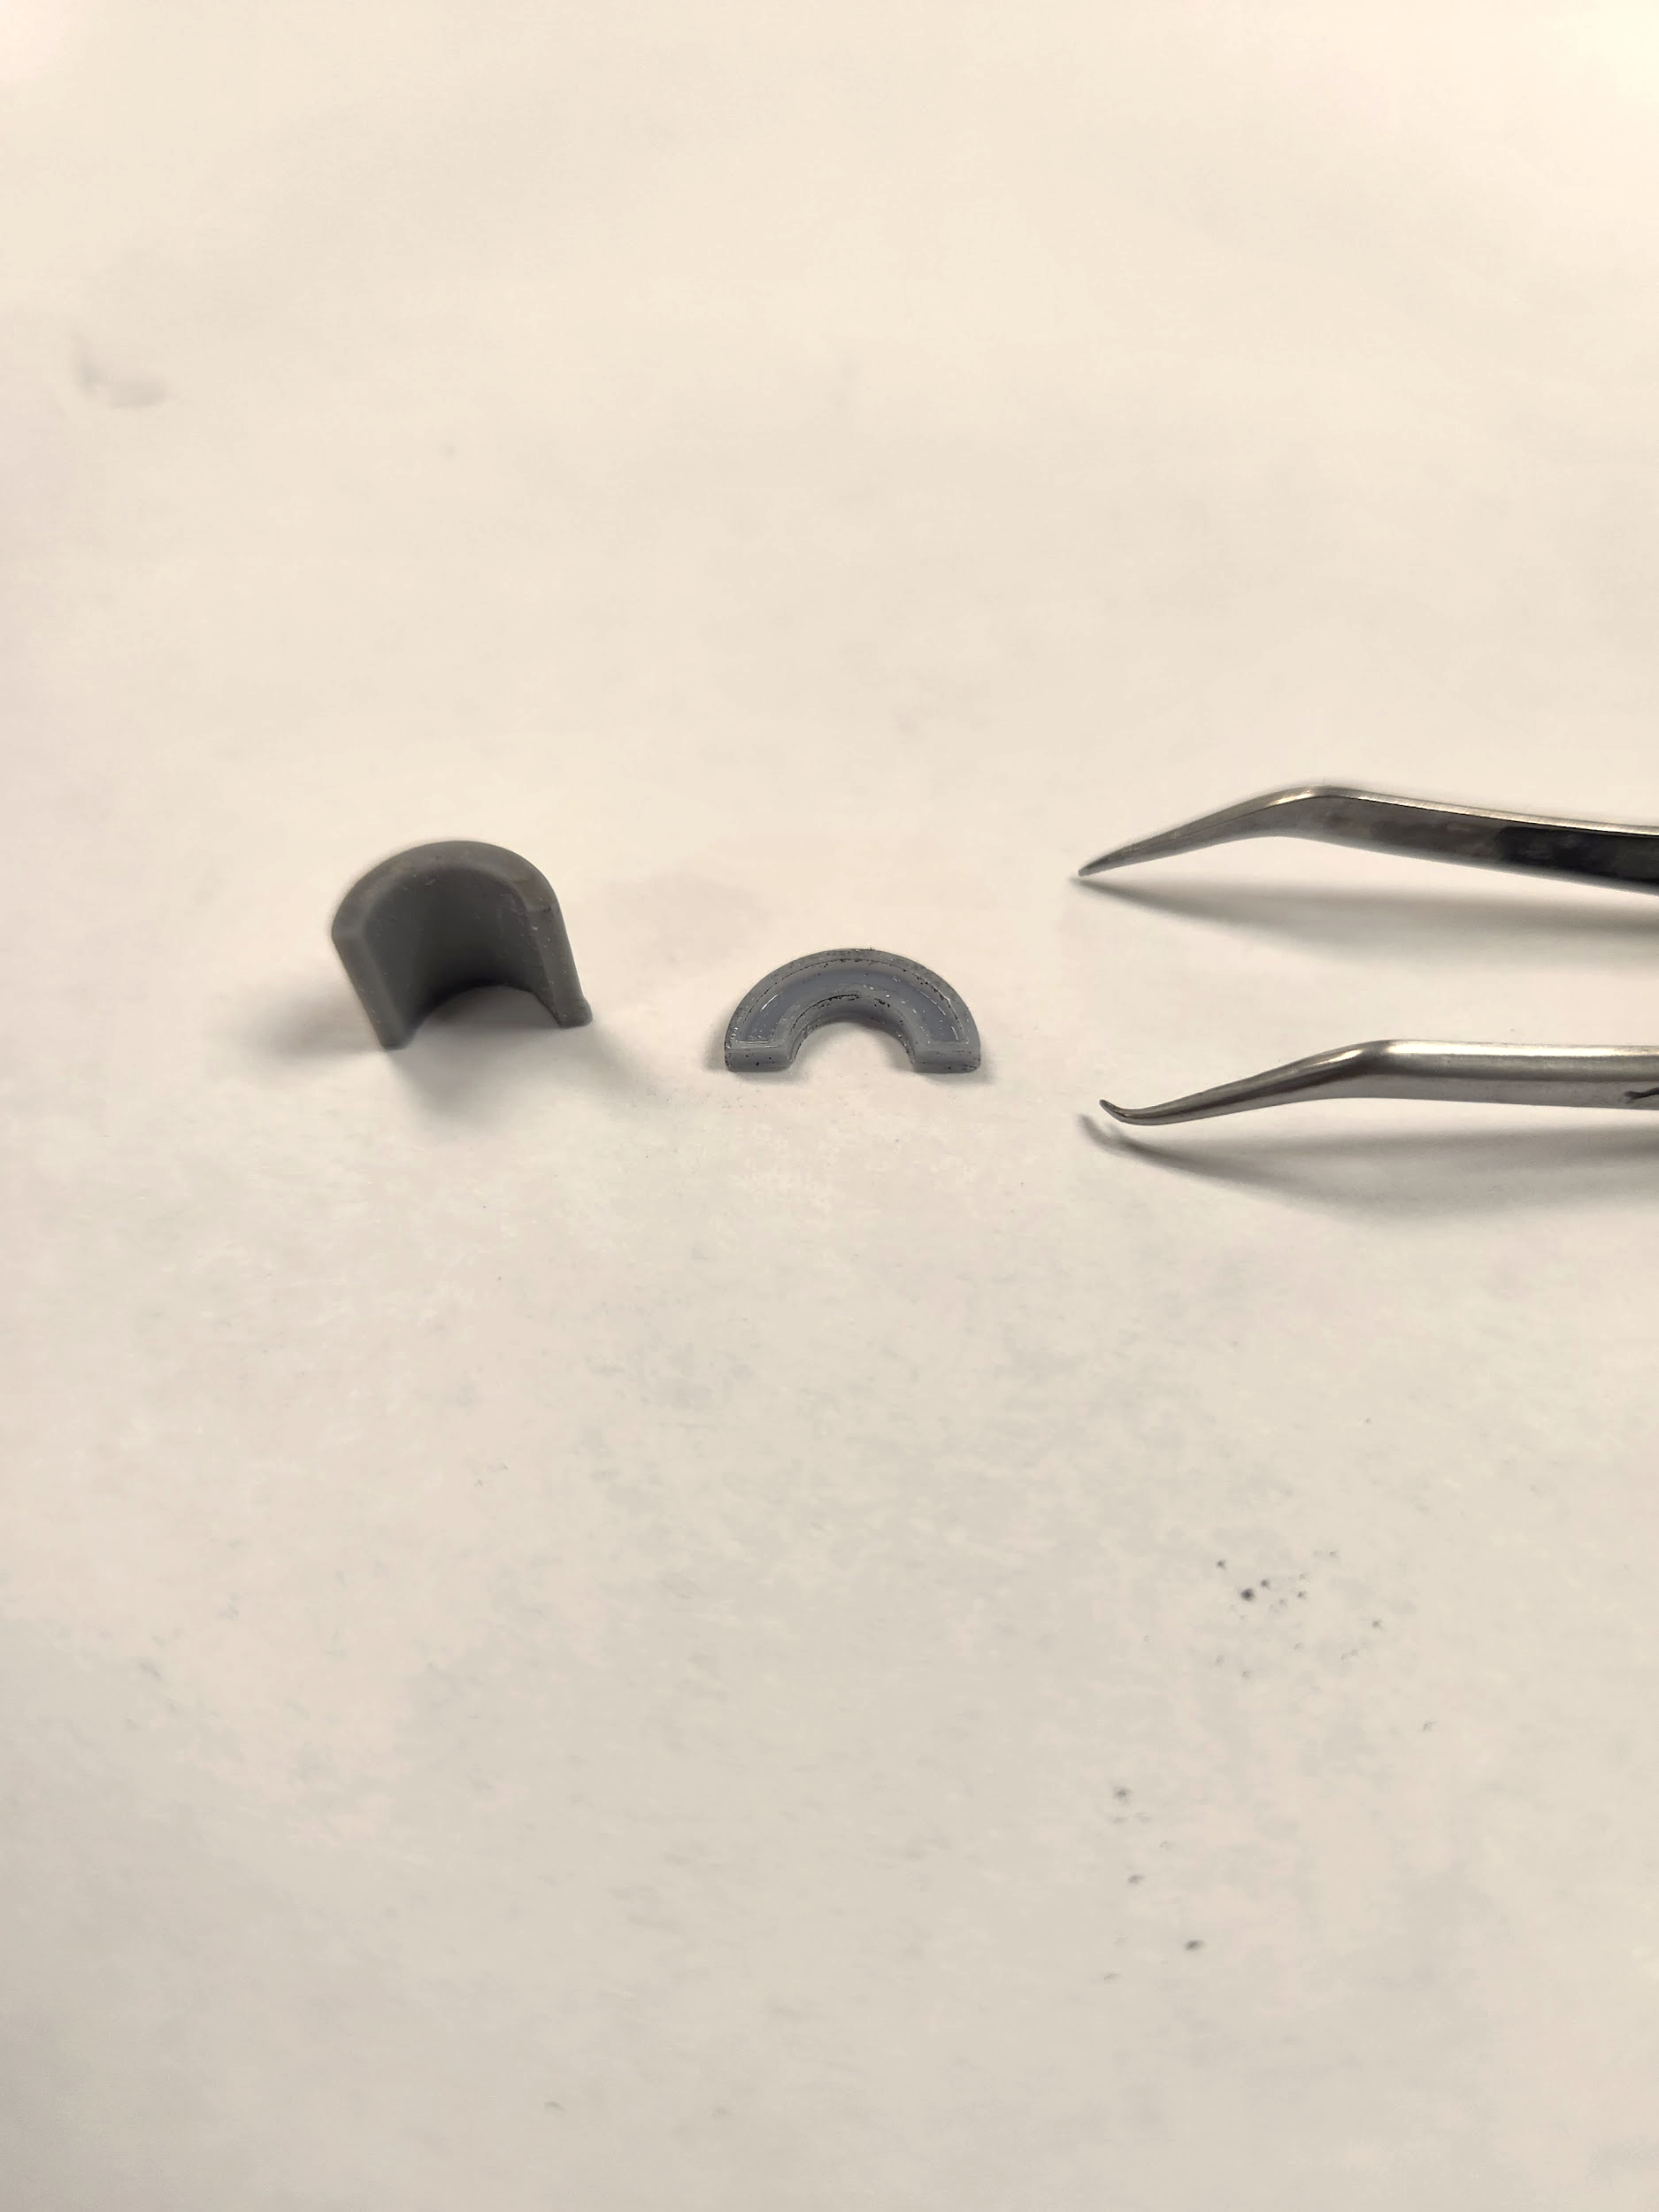
Issue 2: Hard to Handle due to Small Size
Difficult to fill
Difficult to make changes to finished product
Makes the P and N parts more fragile
Future Improvements:
Make the parts thicker and bigger to overcome issue of size

Slide 21
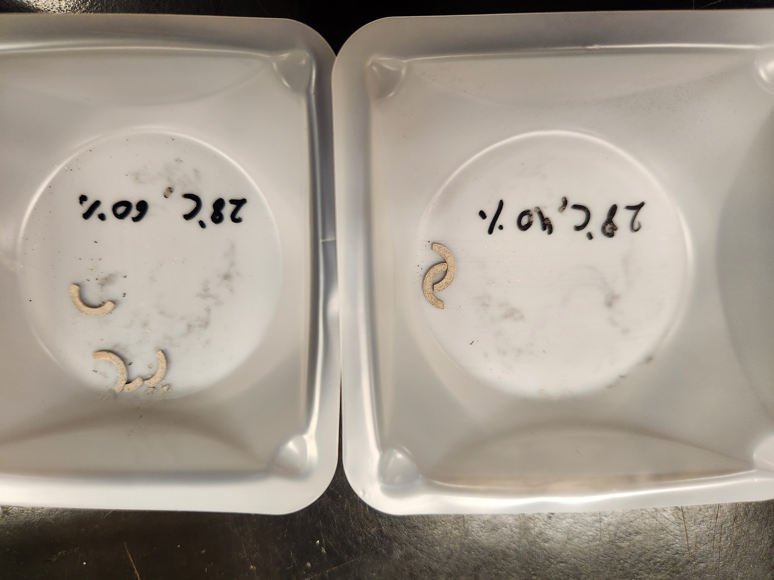
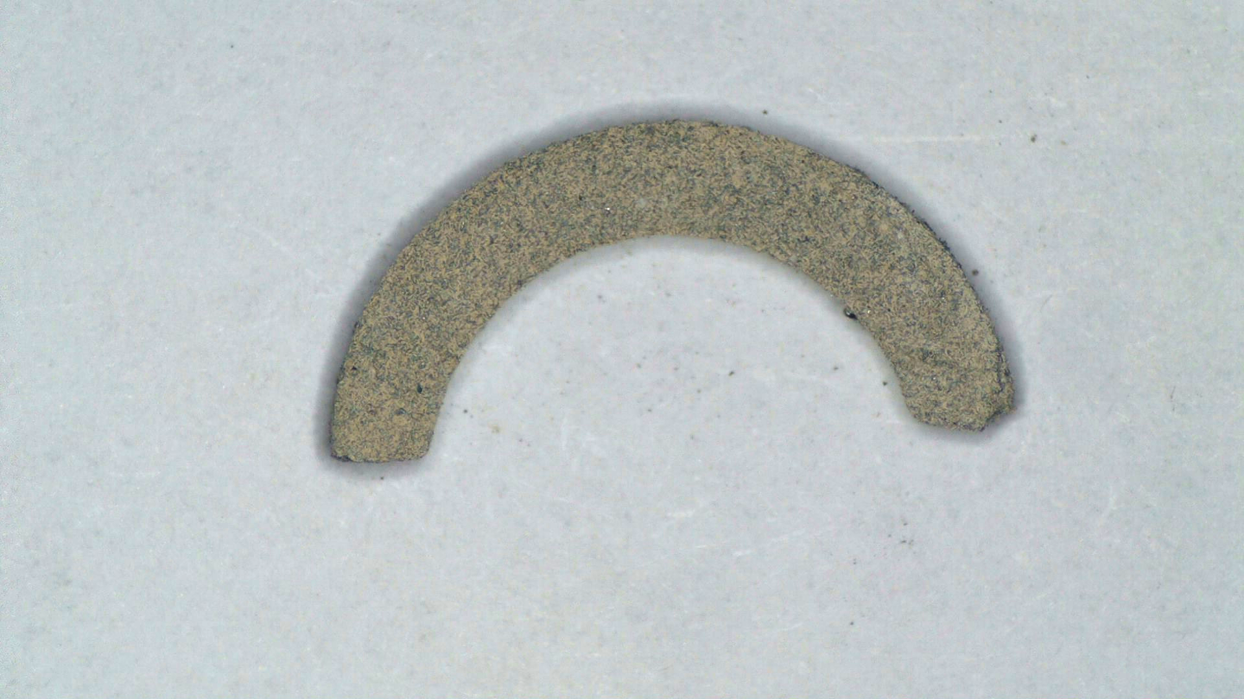
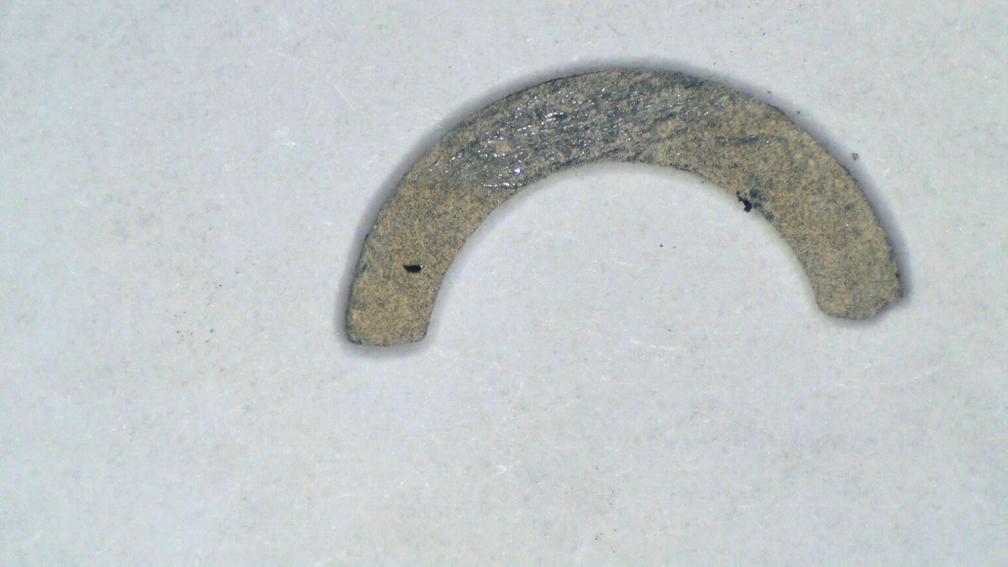
Issues 3 & 4: Brittle, Contaminated by Polymer Ash
The parts were extremely fragile, some of them cracked and broke in the furnace. Some broke while being moved to a new location (see image on the left).
The parts had a large amount of surface deposition of oxides as well as polymer ash (see centre image), which made them non-conductive and unusable for the n-p-n-p junctions we were trying to make.
The difference between the surface impurities and semiconductor underneath are clearly visible in the image on the right, where we attempted to scratch the surface to expose the material underneath.

Slide 22
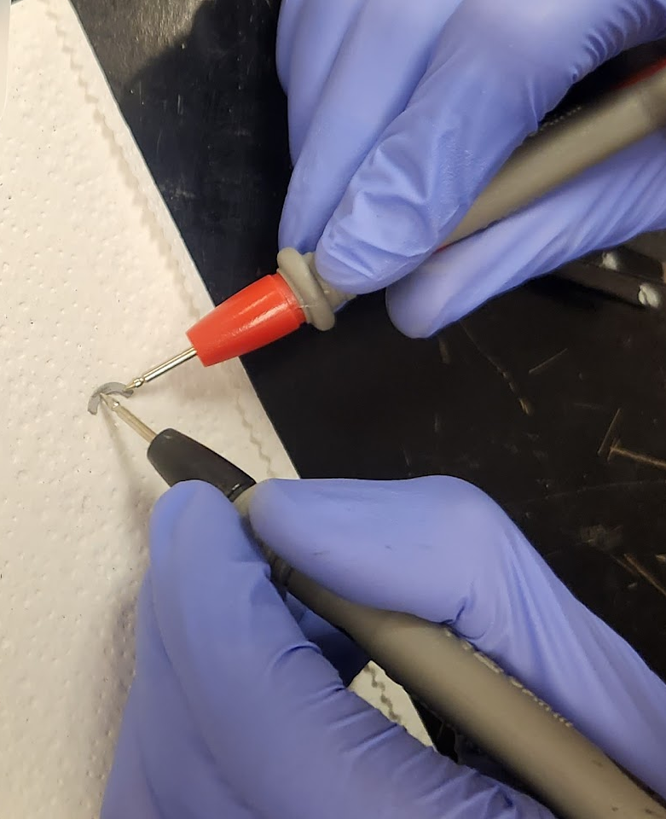
Main Issue
P and N parts are not conductive

Slide 23
Findings & Conclusions
During the process of sintering the P and N type materials in the furnace, a layer of ash was deposited on top of them.
Unfortunately, this ash layer renders the components not conductive by blocking the path of electricity flow between the parts, inhibiting their ability of Thermoelectric Generation (TEG).
Future Improvements:
From literature we learnt that furnace sintering is not suitable for the particular TE material we used. In future, advanced techniques such as laser sintering and plasma arc sintering can be employed to manufacture parts that are free from such surface impurities.

Slide 24
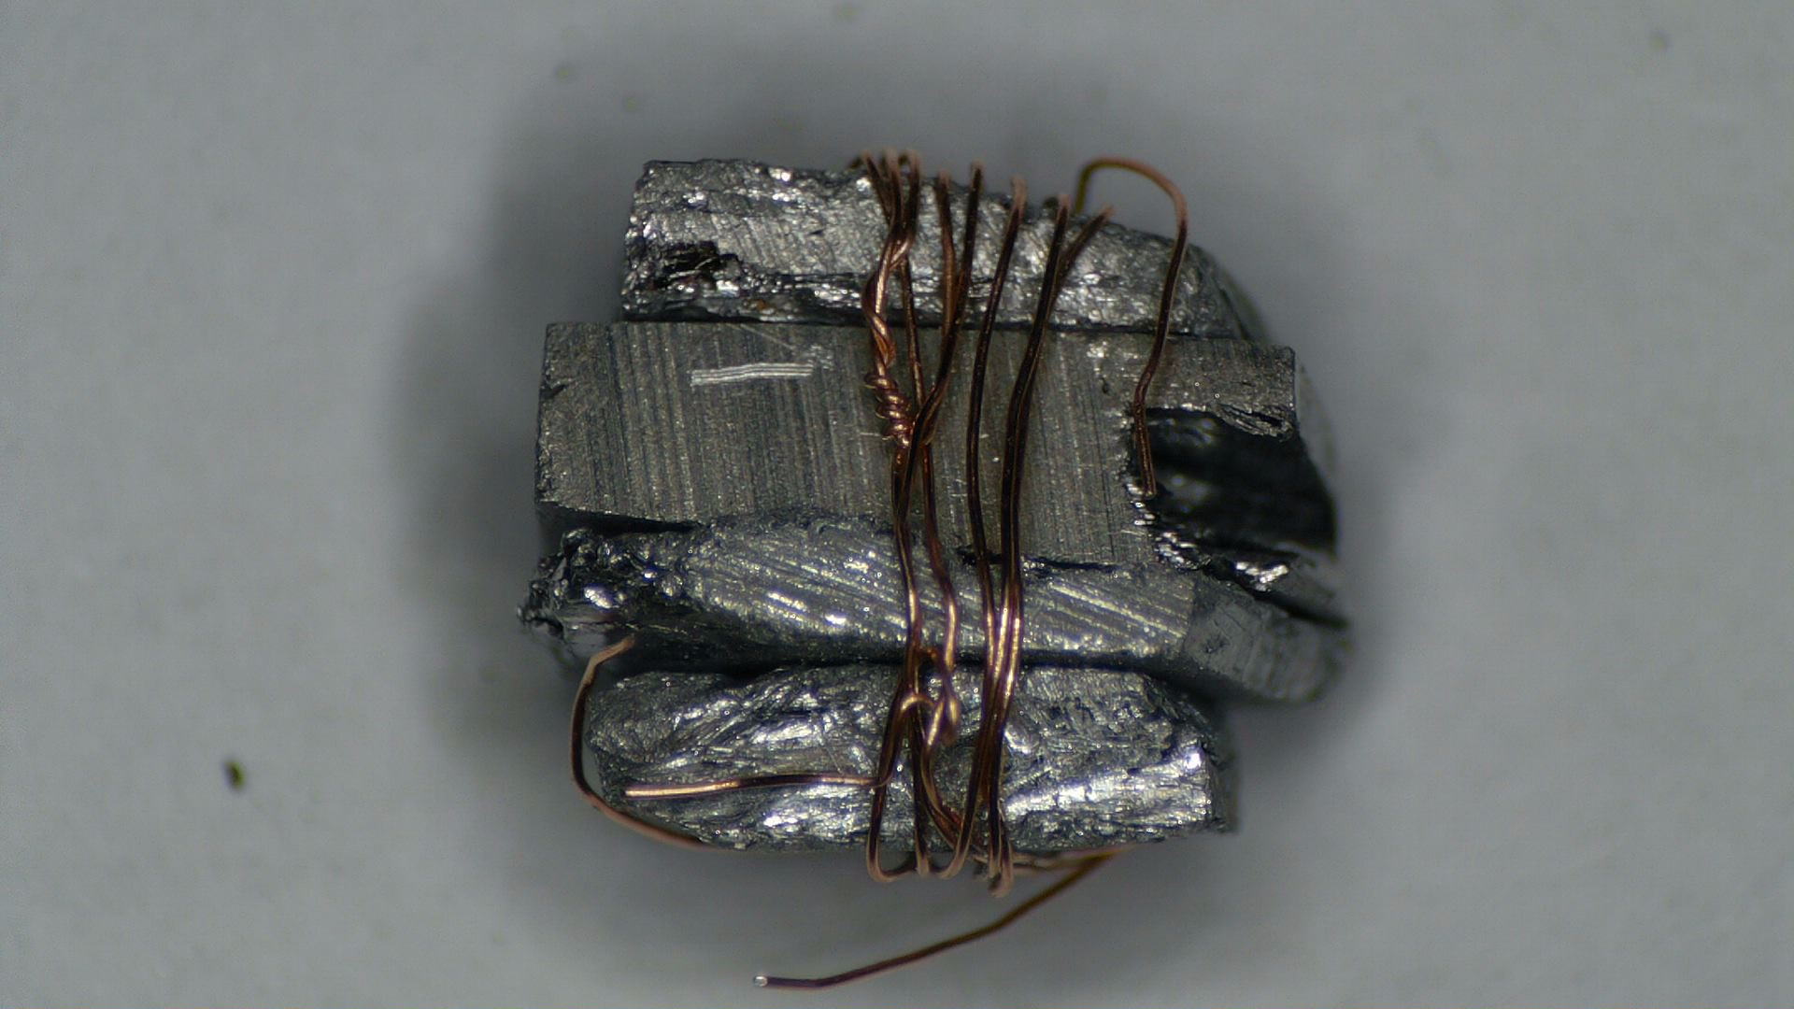
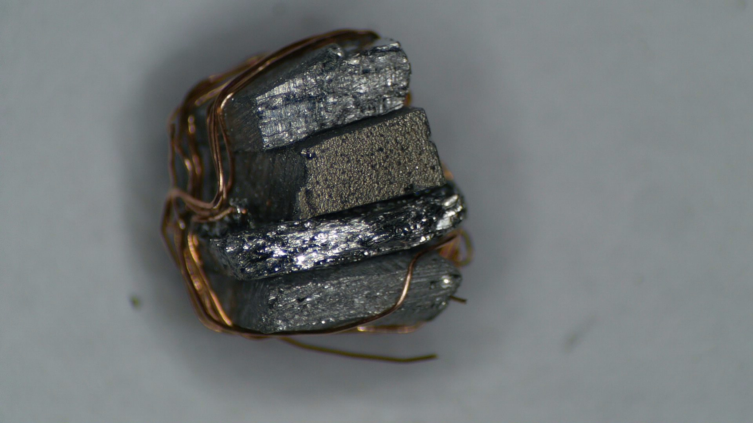
Attempt to Create the TE Junction with solid material
After the sintered parts failed to display the TE effect due to the issues we discussed, we attempted to create and test the TE effect in a junction made of solid n- and p-type materials (See images below).
However this did not display the desired effect.
We learnt that the solid material did not work due to the misaligned grain structure in the material as well as poor surface contact between the parts. (We were grinding and sintering in order to overcome this issue in the first place)!

Slide 25
Thank You!

Slide 26
Any Questions?

